Slide 1
Building a
classroom-to-career pipeline in New York

Slide 2
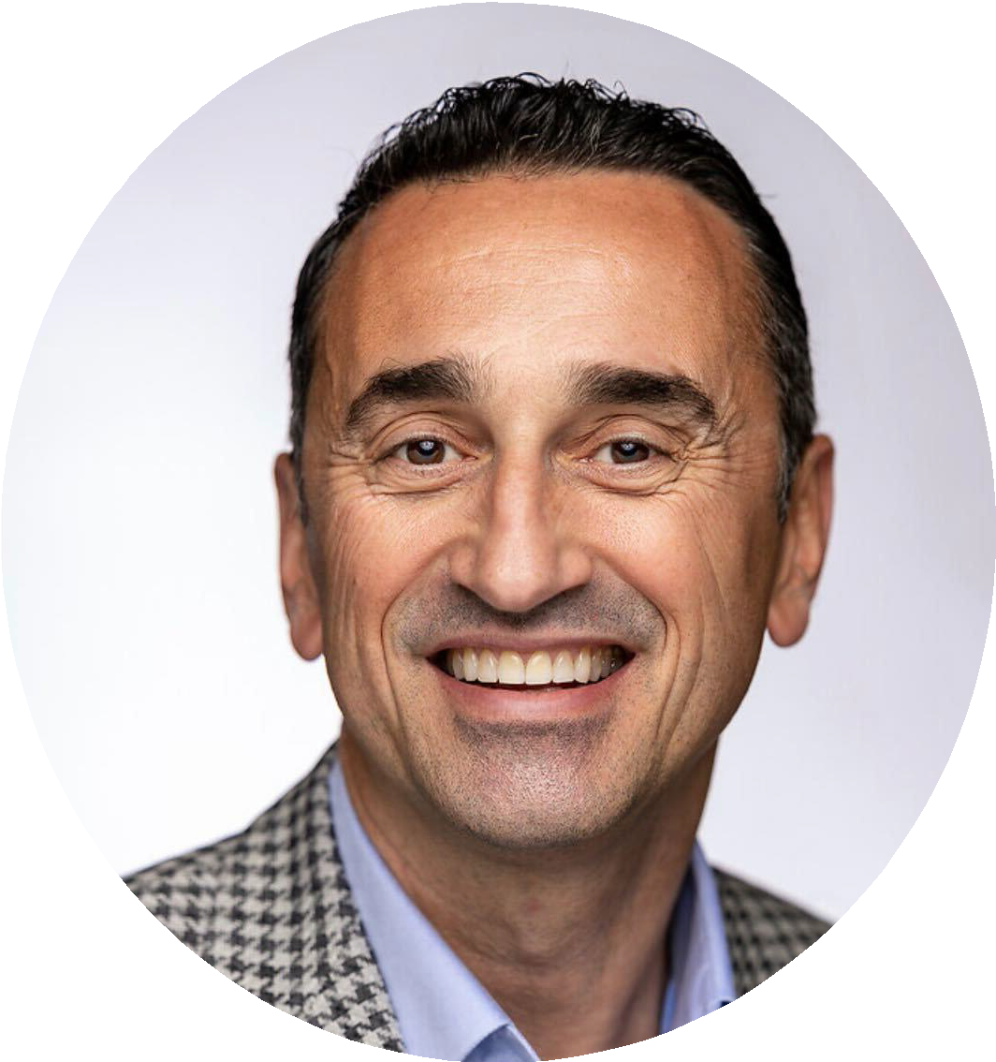
Our Partners & Presenters
Todd Sloane
Director, Workforce & Career Solutions
Finger Lakes Community College
Isai Pochtar
Workforce Advisor Transfr Inc.

Slide 3
WHY ARE WE HERE
- PARTNERSHIPS
Key Components of the workforce development pipeline:
Employers
Workforce Boards
Community Colleges
Elementary, Middle & High Schools
Pre-Apprenticeship Providers
Community-based Organizations
Re-entry Programs
Veterans
It takes an ecosystem to build our workforce!

Slide 4
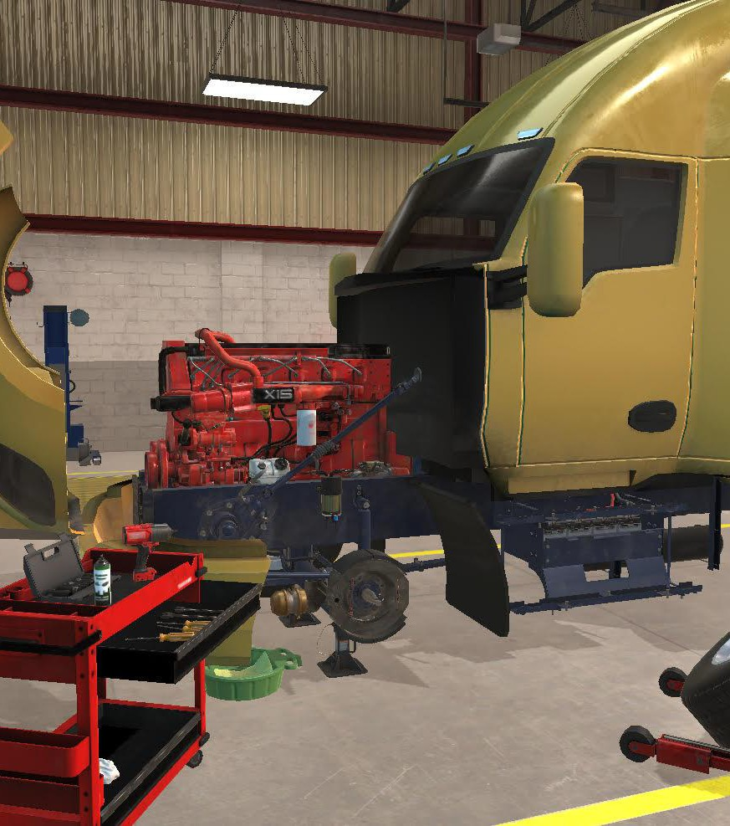
How Transfr Can Support
Technical & Community Colleges
1.
Non-Credit Certiﬁcate Programs
2.
Custom Corporate Training Programs
3.
Apprenticeships
4.
Career Exploration
5.
Credit Programs
6.
Future Programs
"Transfr enables us to provide high quality hands-on, work-based learning experiences. We’ve dramatically increased interest in enrollment as a result."
- CTE Program Director, College of Marin

Slide 5
Growing Rural Infrastructure Together
flcc.edu/grit

Slide 6
The ecosystem
Employers [Workforce Needs]
Vitality
Education & Training [Impact, Relevance]
Households [Individual Needs]

Slide 7
Employer/Workforce Landscape
Pre-COVID
Baby Boomers doubled the labor force from the 1960’s through the 1990’s
These Baby Boomers started retiring in 2002
Before COVID, unemployment was at an all-time low (~1.5%)
There were 2 people per job opening, but only 1 was looking!
The percent of people aged 55+ looking for work drops.
The labor participation rate (%) consistently drops
COVID accelerator
Labor participation rates plunge (and have not returned)
~5 million took themselves out of the labor market not to return.
Job postings increased by 2 million (from 7 million to 9 million)
25 Million lost their jobs
Chamber surveyed about half…
Only 1/3 of these are actively looking for work
7

Slide 8
Weathering the storm new world
What won’t work by itself
You can’t recruit your way out of it
You can’t buy your way out of it
You can’t ignore (avoidable) attrition
The Right Questions
Why work for us?
All else equal
What will make a signiﬁcant difference
Attracting the right people
Retaining the right people
Unleashing their capabilities
Why do people leave?
Why do people stay?
8

Slide 9
Key Learnings potential participants
*Love of the region
Strong and local
Ease of Support ( systems) Varied greatly
*Broadband
Strong & uneven
Sense of belonging
Varied, stronger once connected
*Transportation
Signiﬁcant Challenge
Awareness of opportunities Varied
Key drivers
Stability
Career Family

Slide 10
Essential Question
Given these employer & household needs…
How might we strengthen our (community college) capacity to serve as critical economic growth engines for their learners, employers and communities?

Slide 11
Prototype Elements
Learner Core Needs
Learn where I live and where local jobs are. Eliminate commute and schedules that conﬂict with my life priorities.
Local Access
Relevancy & Immediacy. Gain marketable skills that enable employment or advancement soon. Especially in a stable long-term ﬁeld or career.
Relevance & Immediacy
Easy Navigation. Have a single person who can assist me with navigating my learning start-to-ﬁnish. Know that someone cares about my situation.
Personalized Support

Slide 12
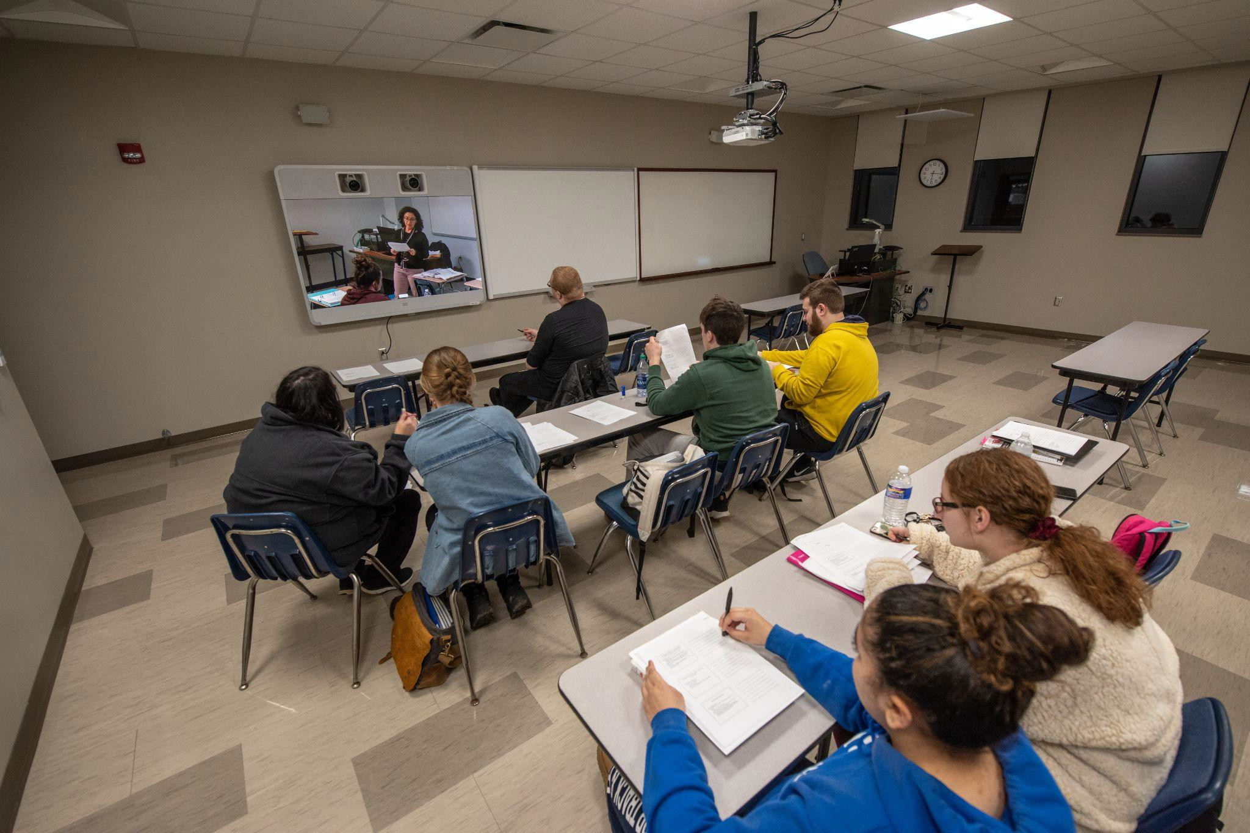
FLCC GRIT - Community Sites
GRIT
Community Sites
Local
Training Delivered at local community sites:
Site provides space for learning
Time for programming
College provides
Technology for live remote instruction
Employer-validated curriculum
Learners apply through college
Funding applications done in background

Slide 13
FLCC GRIT - Distributed Learning
GRIT
Community Sites
Local
Knowledge-Based Learning | Hybrid | Live online at local sites
Knowledge-Based Assessment | Hybrid | Online Live and async
Skill-Based Learning | Virtual Reality | Live onsite, at-home
Skill-Based Assessment | Virtual Reality Portable Lab | Local sites, at-home Local sites
Company Specific | Company Site | On-the-job training

Slide 14
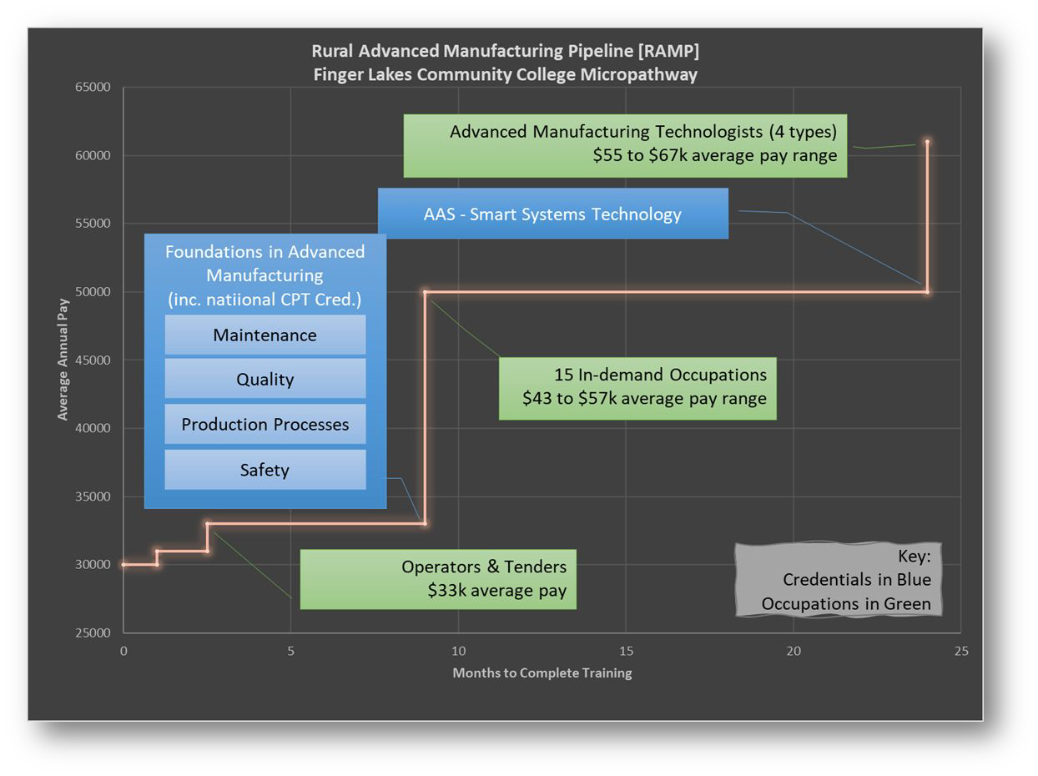
Pilot Launch Phase FLCC GRIT
Credentials that are:
In a high growth sector
Relevant to in-demand occupations
Employer Validated
Attainable quickly (ideally less than 6 months)
Micropathways

Slide 15
Pilot Launch Phase
FLCC GRIT - Feb through May, 2022
Sites
Yates County Workforce Development
Penn Yan, NY
Bloomfield CSD Learning Lab
Bloomfield, NY
At Home
Program
Certified Production Technician Plus
National Certification High-growth sector
13 in-demand occupations
Outcomes
13 enrolled
12 completed
11 received credential
11 employed in sector within 30-days of completion
Proof of concept:
6, 2, 5 enrollment provided
access to all who otherwise would not have had it.
Format provided access for
employed and underemployed

Slide 16
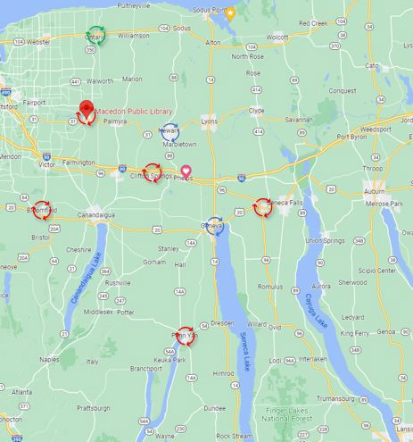
FLCC GRIT - Scaling the model
Additional sites
Initial community sites: 2 New community sites: 3 Campus centers added: 2 Workplace Site: 1
Programming Pathways Health Care (LTC lattice) IT (AWS Academy)
Education (teaching assistant)

Slide 17
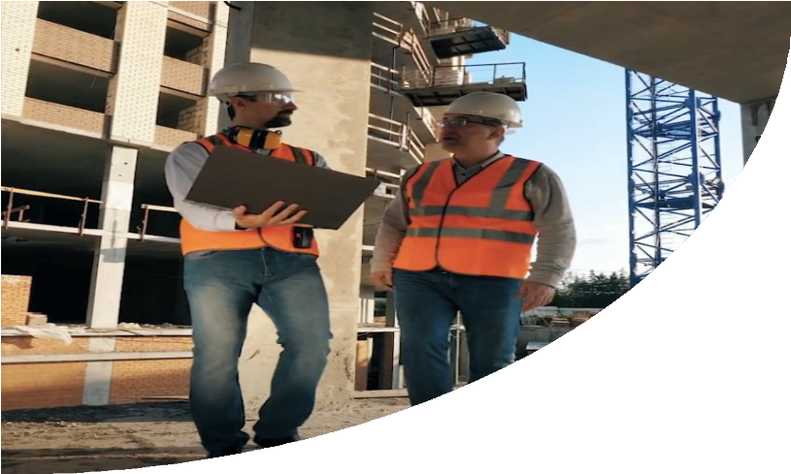
Transfr Is on a Mission
Transfr’s mission is to train the future of every industry and open up new opportunities for people across the globe.
We create unique pathways to well-paying jobs available now in high-demand ﬁelds, enabling learners to ﬁnd job security and economic prosperity, facilitated by immersive, hands-on training.

Slide 18
Transfr Learning Experience - Company Partners
To Provide Job Seekers With Industry Relevant Training
AIDT And Lockheed Martin Develop a pre-employment training program
Charles-Henderson High School
Deploys Transfr through MSSC
curriculum utilizing WIOA funding
2
AIDT and Toyota-Mazda Development an incumbent-worker training curriculum
AL Governor’s Oice Creates Jumpstart AL
A public/private partnership
to Develop the next generation of labor
4
Department of Commerce Incorporates Transfr into Governor’s Budget to drive demand for four automotive OEMS
5
1
3
"We want to promote a positive culture, a positive picture in the community, and say that you can come here and learn a craft, you can come here and learn a trade, and you can be successful within Mazda Toyota."
-Marc Selby, Paint Manager, Mazda Toyota Manufacturing

Slide 19
43%
Of 18+ Year Olds
HAVE NOT ACQUIRED ADVANCED DEGREE
8,577,582
Residents (25 and Older) Without A High School Degree
1,673,580
NY Age 25 And Older That Did Not Graduate High School Or Have A High School Equivalent
Students
Who Do Not Pursue Higher Ed
3,929,064
Students age 18 and up. Graduated High School And Did Not Pursue Higher Education Learning
New Yorkers 18 years and older
19
Have some college or associate degree or lower.
Source: Census.Gov

Slide 20
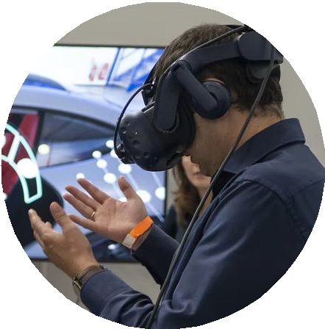
A Student’s Journey
from classroom-to-career
2
4
Academic Pathway
Join the Workforce
1
3
5
Career Exploration
Learn and Earn
Career Advancement

Slide 21
Why Virtual Reality?
Improve equity and access
No need to build new training facilities
Increased student comfort and aractiveness
1:1 Learning - Practice skills in truly personalized learning environment
Improve learning retention by 4x
Improved job placement rates

Slide 22
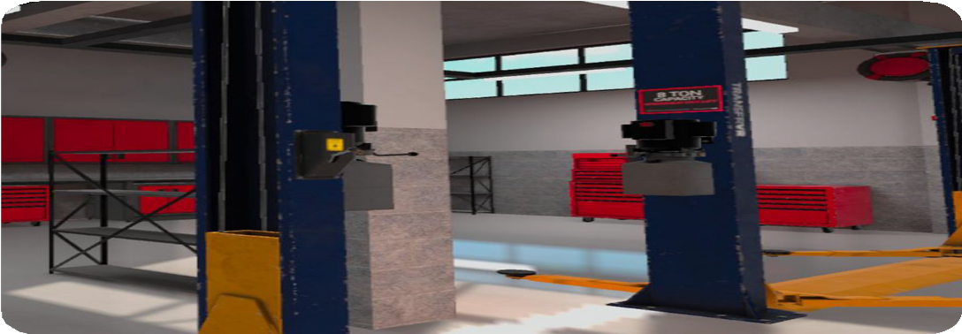
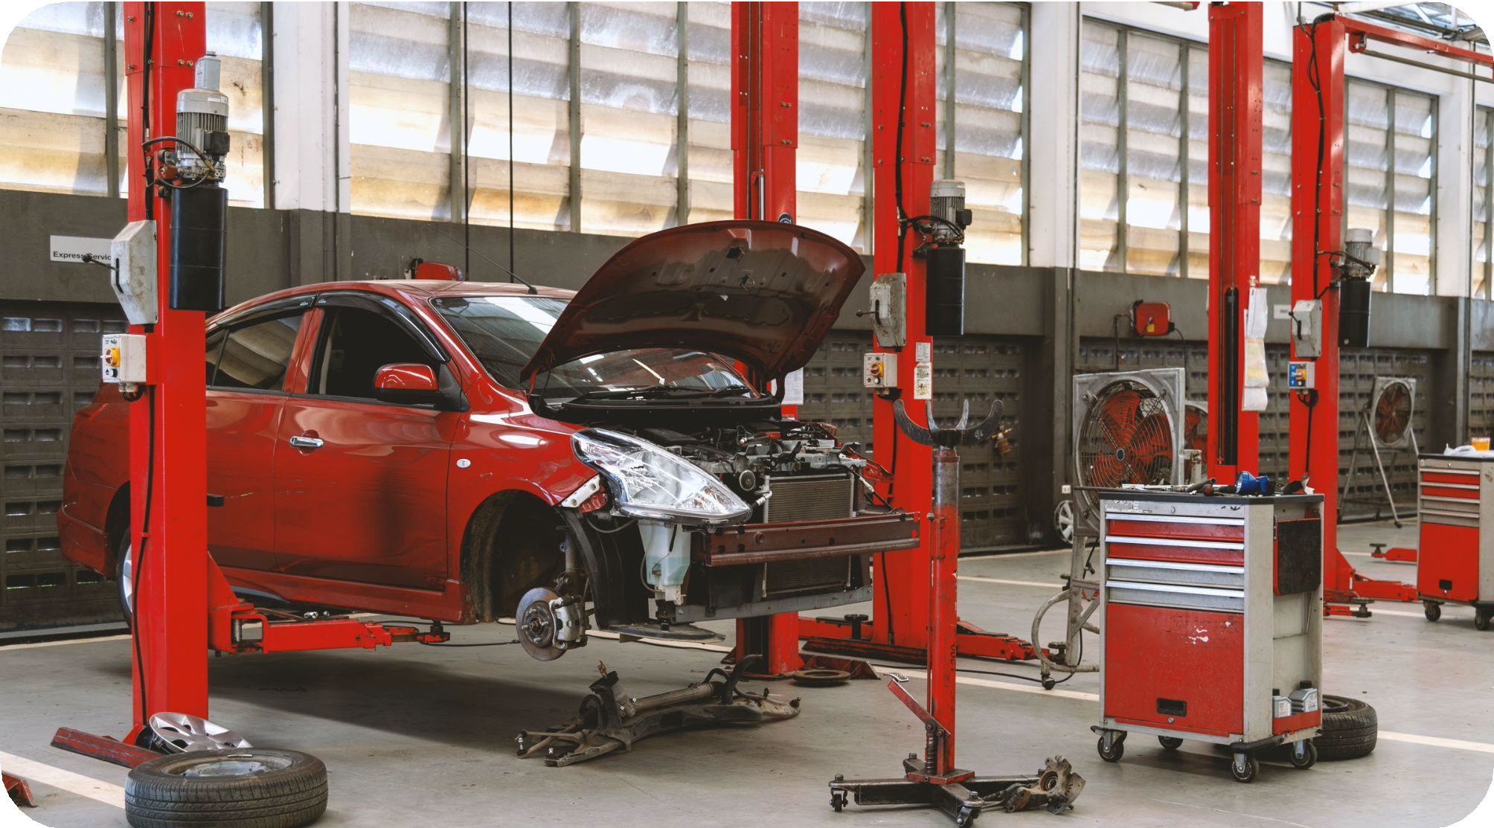
VR
Environment
Transfr partners with industry to provide hands-on training simulations that replicate the job site.
By bringing a company's training facility to a community, we can build a local talent pipeline.
Actual Garage

Slide 23
Industry
Credentials
That Transfer Helps Support:
MANUFACTURING
MSSC Certiﬁed Logistics Technician (CLT)
MSSC Certiﬁed Production Technician (CPT)
NC3 manufacturing certiﬁcations
MECHATRONICS
AUTOMOTIVE
CONSTRUCTION
Siemens Level 1 Certiﬁed
Mechatronic System Assistant
Smart Automation Certiﬁcation Alliance (SACA) Certiﬁed Industry
4.0 Associate
ASE
ICAR
NCCER
OSHA 10
OSHA 30
- NC3 mechatronics certiﬁcations
Example Transfr Modules Include:
Example Transfr Modules Include:
Example Transfr Modules Include:
Example Transfr Modules Include:
Plant Safety
Precision Measurement
Blueprint Reading
- Precision Measurement
Plant Safety
Mechatronics
Automotive Fundamentals
Auto Body / Collision
Precision Measurement
Construction Safety
Precision Measurement

Slide 24
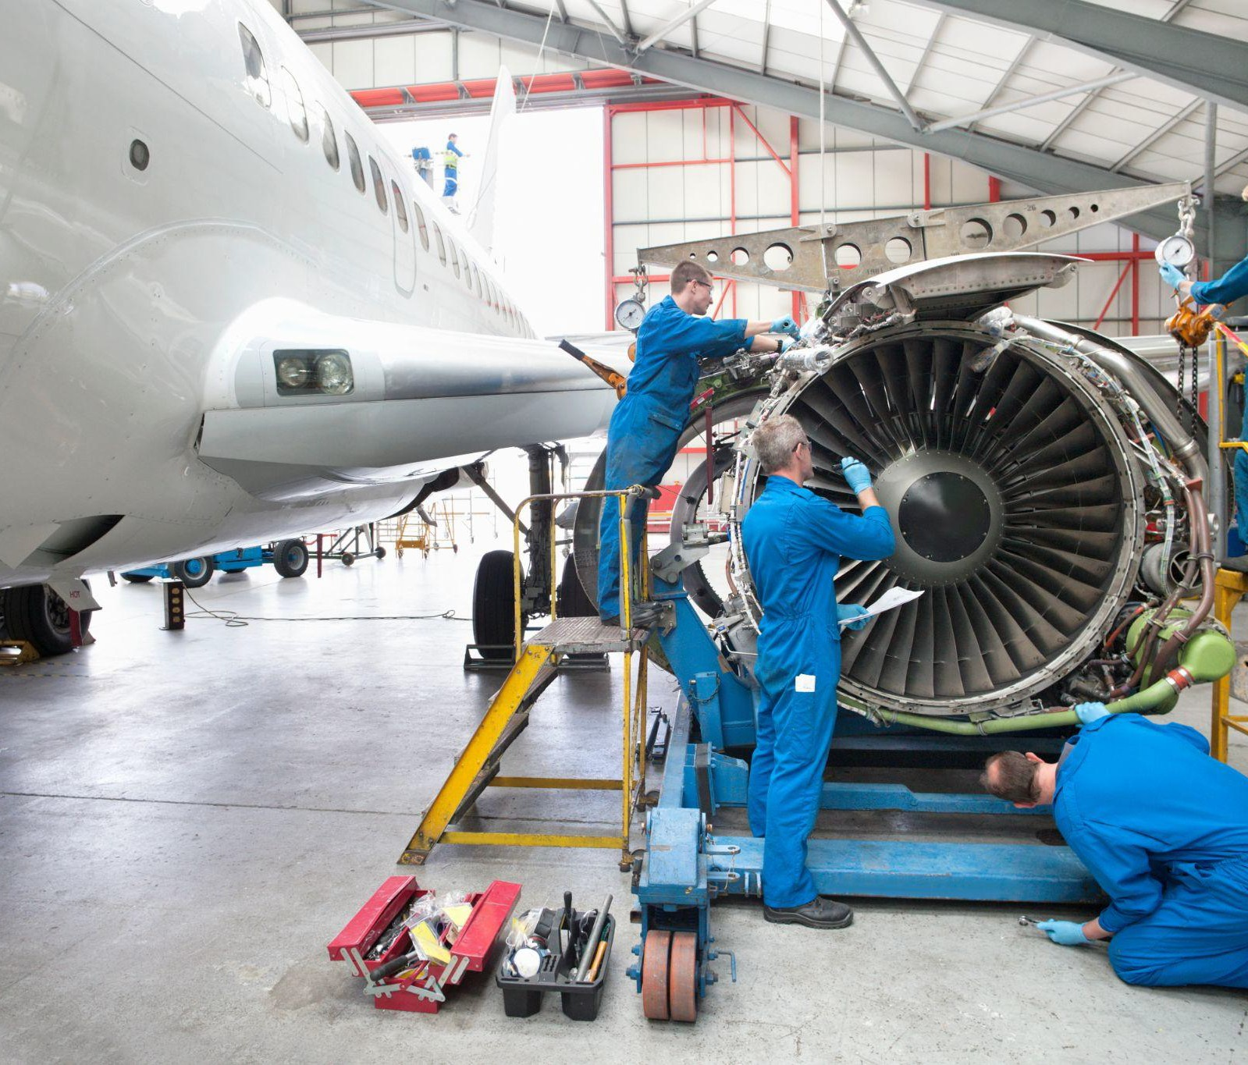
Aviation Maintenance
Construction
Healthcare
Automotive
Diesel Technology
Transfr offers training in high growth industry sectors.
Transfr Product Catalog
Electrical Construction
Hospitality & Tourism
Manufacturing

Slide 25
Key Takeaways
Developing Ecosystem Partnerships with Industry and Community
Introducing Immersive Experiences and New Technologies
Creating Opportunities for Communities
Building a Work-Ready Talent Pipeline

Slide 26
Contact Us:
Isai Pochtar Transfr, Inc.
Northeast Workforce Advisor
Todd Sloane
Finger Lakes Community College Director, Workforce & Career Solutions
todd.sloane@flcc.edu
ipochtar@transfrvr.com
www.transfrinc.com

