Slide 1
Sector Neutral Concepts in Customer Service/Leadership Training Partnership project
CEANY Workshop November 10, 2022 3:30-4:30pm

Slide 2
Partnering with Community Organizations and Employers
Approached by Capital Region Employer Resource Network (ERN) to partner in providing Professional Development trainings to ERN member employers.
Businesses across industries identified similar needs for Customer Service, Supervisory Leadership and Diversity, Equity and Inclusion Training for their employees.

Slide 3
Collaboration not Duplication
Rather than developing trainings in-house, we contracted with training partners in our area who specialize in this type of work to offer these trainings to employers.

Slide 4
WDI CFA Grant Application
3 month grant application process which included development of partnerships and employer commitment
Received commitments from 7 employers, established n expected number of participants, and determined required cash/in kind match
Received quotes from training partners on cost to provide the trainings
Created narrative and budget
Timeline:
Submitted Application: December 2021
Received Approval: February 2022
Completion date: August 2022

Slide 5
Training Management
Upon approval, a timetable was established
Developed marketing documents to share with employers
Developed registration and billing process to manage grant funds and employer match
Shared registration information with trainer who then managed online/in-person training from their platform
Created spreadsheets for attendance and outcome tracking for grant report

Slide 6
Outcome Evaluation: Customer Service
Successes:
20 hour Customer Service Training
7 employers participated sending 55 employees to the training
Employee retention and promotion;
Increased productivity and communication/teambuilding;
Improved customer service and improved company culture
“Our employees have not had many professional development opportunities since the pandemic. This training was well received by our community as we have many front line and middle management participants. This training provided learning topics that we could learn, discuss and apply to the work that we do each day.”
~A. Hobb ARC of Rensselaer County

Slide 7
Outcome Evaluation: Supervisory Leadership
Successes:
18 Hour Supervisory Leadership Training
11 employers participated sending 78 employees to the training
Employee retention/ decreased turnover
Increased productivity and communication/teambuilding
Increased Employee confidence, quality and efficiency
Improved customer service
“Many of our supervisory and management employees have been employed by us for many years and we promoted from within without any formal supervisory training. Participants really enjoyed engaging with peers from other organizations and learning about their experiences. Participants reported that they acquired tangible strategies and skills that they plan to implement into their daily routine all participants recommended that other supervisors and managers within our organization be provided the same training in the future.”
~K. Biehler OrthoNY

Slide 8
Outcome Evaluation: Diversity, Equity & Inclusion
Successes:
3 hour Diversity Equity and Inclusion training
3 employers participated sending 17 employees
increased communication/teambuilding
improved company culture
increased quality and employee confidence
“This program offered a concrete and understandable overview of DEI. It provided a useful “roadmap” to continue to develop our DEI goals and initiatives.”
~J. Canale Schenectady County ARC

Slide 9
Challenges & Lessons Learned
Challenges:
Tight timeframe to offer trainings within grant framework
Employers over-promised on # of employees they would register
Grant income was based on per student reimbursement model
Lessons Learned:
Offer training at multiple times throughout the year
Don’t use employer’s maximum number of employees for budget development
Structure grant reimbursement on training sessions offered rather than # of students

Slide 10
Future Offerings & Sustainability
Based on the success of this project, we are working with trainers and partner organizations to develop a sustainable and affordable suite of professional development trainings to meet the needs in our community.

Slide 11
Next Steps: How can this work be best capitalized upon to grow partnerships in your region?
Building Partnerships:
Methods to identify training needs in your region?
What community partners in your region could you work with ?
What employers would benefit from this type of need?
Have employer surveys been used to identify training needs and if so, to what success?

Slide 12
Training Development Process: Let’s Talk About it
You receive an inquiry from a local business in need of contextualized sales, marketing and business behavior training. How do you respond to this request?
What in-house or “off the shelf” training products does your organization have? Can they be contextualized and/or modified for the particular needs of a company partner?
What funding resources can support this training project: grant, federal/state funds, donor, etc? How do you vet students through funding eligibility?
Are there credit courses that would support this training request? How would you work with internal college colleagues to open these courses to employer partners?
Are there training vendors with whom you work that can provide some aspects of the training project?

Slide 13
Training Development Process: Let’s Talk About it
What faculty members could provide expertise in this area? If so, what is the process for utilizing campus talent?
Would other employer partners would benefit from this training program?
How will you market this program? What part does the employer partner play in recruitment/marketing?
What does success look like—what outcomes are most important to your stakeholders?
Student/Employer
Employer
Funder
College
Stakeholder Mapping
Sustainability: What SUNY products can be used to support being a feeder to credit or other further education opportunities?
Articulation
Industry Recognition
Micro-Credential
Pathways

Slide 14
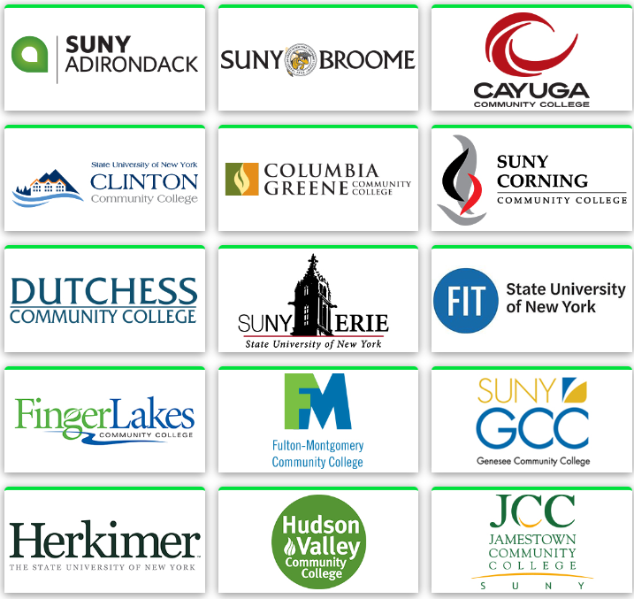
Key Take Aways:
Customer Svc, Leadership/Supervisory & DEI are needed across all sectors
How can this work serve the largest number of regional employers?
Funding:
What funding streams can support this kind of work beyond the CFA?
“To Work” funding requires a viable job upon completion; Work behaviors/Soft skills are not sufficient on their own
Some exciting developments we are seeing as a result of offering these trainings:
Pathway Development: Articulations, Micro Credentials, Industry Recognized Credentials
Sustainability: Currently informing credit side development and updates to course work: Business Division, First Year Seminar

Slide 15
Contact Information
Sarah Wilson-Sparrow
VP of Workforce Development and Community Education
SUNY Schenectady
wilsons@sunysccc.edu
518-595-1101 ext 7
Michelle Kraines
Coordinator of Workforce Development and Community Education
SUNY Schenectady
krainesm@sunysccc.edu
518-621-4007

