Slide 1
Providing Solutions to Your Community's Healthcare Job Demand
Presented By:
Amber Cloke, Program Coordinator
SUNY Corning Community College
Lori Mendicino, Academic Partner Account Executive
CareerStep

Slide 2
SUNY Corning Community College
A public community college in Corning, New York - initiated in 1957 & moved to Spencer Hill Campus in 1963. SUNY Corning serves 3 counties: Steuben, Chemung & Schuyler.
Workforce Education & Academic Pathways (WEAP) offers a variety of non-credit training, certification training, credit programs, short-term trainings & micro-credentials.

Slide 3
CareerStep
A private organization based in Lehi, Utah that began providing allied healthcare training 25+ years ago. CareerStep partners with academic & healthcare institutions to offer non-credit training programs where learners prepare for national certifications so they can begin new careers in healthcare or advance their career.

Slide 4
WHERE WE STARTED
THYNK UNLIMITED
Jeanne Eschbach returned to CCC in 2016
CCC Workforce had no staff & very few trainers
Faced with building an entirely new portfolio
Jeanne reviewed Jobs in Demand data & our Workforce Development Board's Occupation List
Pharmacy Technician was on both lists
Workforce had previously offered this program in-person, but our curriculum was not nationally certified, our previous instructors were no longer available & was struggled to fill a class (at least 8 people)
At this same time, a representative from CareerStep reached out to Jeanne
We started with one program: Pharmacy Technician

Slide 5
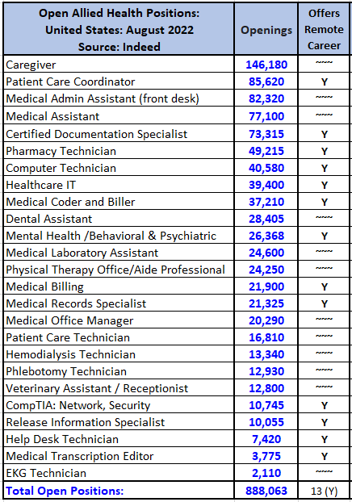
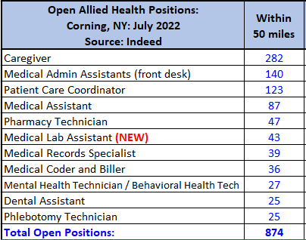
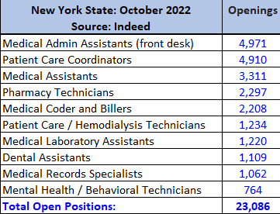
ALLIED HEALTH JOB DEMAND
UNITED STATES
CORNING, NEW YORK
NEW YORK STATE

Slide 6
CERTIFICATIONS
Requirements Validation, Voucher Distribution, Exam Scheduling, Certification Data Passback
LEARNING FRAMEWORK
Quality, Convenience, Service
BENEFITS
OUTSTANDING CONTENT
Regularly updated courses, industry expert instruction, innovative education, pathways to certification

Slide 7
ADVOCATES
TECHNICAL SUPPORT
SUPPORT AGENTS
PARTNER SUCCESS MANAGERS
INSTRUCTORS

Slide 8
OUR PARTNERSHIP
STARTED OCTOBER 31, 2018 - JUST OVER 4 YEARS AGO
Purpose: To offer quality allied health training to SUNY Corning's community so learners can gain the skills & knowledge, become nationally certified, & begin new careers in healthcare. Learners are hired at various types of healthcare facilities - hospitals, clinics, assisted living, doctor offices, pharmacies, etc.
Medical Assistant
Mental Health Technician
Pharmacy Technician
Phlebotomy
Technician

Slide 9
Medical Assistant
NY OPENINGS
3,311
WITH EXTERNSHIP
LEARNER PREPARES FOR ALL 5 EXAMS & RECEIVES VOUCHERS FOR 4:
Certified Clinical Medical Assistant (CCMA)
Certified Phlebotomy Technician (CPT)
Certified Electronic Health Record Specialist (CEHRS)
Certified EKG Technician (CET)
Certified Medical Administrative Assistant (CMAA)

Slide 10
Pharmacy Technician
NY OPENINGS
2,297
WITH EXTERNSHIP
LEARNER SELECTS ONE OF THE FOLLOWING NATIONAL CERTIFICATION EXAMS:
Pharmacy Technician Certification Board Exam (PTCE)
Exam for the Certification of Pharmacy Technicians (ExCPT)
DIFFERENCE BETWEEN PTCB & ExCPT:
The ExCPT (NHA) exam features 100 questions
The PTCB (PTCE) exam includes 90 questions over a 2-hour period

Slide 11
Phlebotomy Technician
NY OPENINGS
657
WITH EXTERNSHIP
Certified Phlebotomy Technician (CPT)
Mental Health Technician
NY OPENINGS
764
2 NATIONAL CERTIFICATION EXAMS:
Mental Health Technician (AHT)
Certified Electronic Health Records Specialist (CEHRS)

Slide 12
THE LEARNER JOURNEY OVERVIEW

Slide 13
2018-2019
PARTNERSHIP ENROLLMENTS
2021-2022
2019-2020
ENROLLMENTS FOR FISCAL YEARS
2020-2021

Slide 14
SUNY Corning | CareerStep
PARTNERSHIP ENROLLMENTS
(SUNY FISCAL YEAR: SEPT. 1 - AUG. 31)
October 2018 - August 2019: 2*
September 2019 - August 2020: 4
September 2020 - August 2021: 17
September 2021 - August 2022: 78
*Partnership began October 2018

Slide 15
SUNY Corning | CareerStep
TOTAL ENROLLMENTS BY PROGRAM
MEDICAL ASSISTANT
Medical Assistant w/ Externship (49)
Medical Assistant (31)
Medical Coding & Billing for Outpatient Services (1)
Medical Coding & Billing (1)
PHARMACY TECHNICIAN
Pharmacy Technician w/ Externship (3)
Pharmacy Technician (2)
MENTAL HEALTH TECHNICIAN
Behavioral & Psychiatric Technician (1)
Mental Health Technician (1)
PHLEBOTOMY TECHNICIAN
Phlebotomy Technician (9)
Phlebotomy Technician w/ Externship (2)

Slide 16
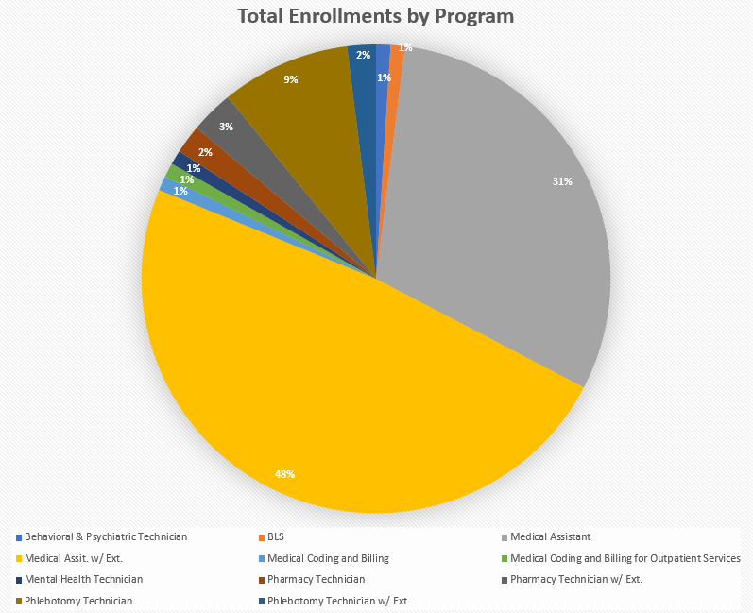
SUNY Corning | CareerStep
TOP THREE PROGRAMS
MEDICAL ASSISTANT
PHLEBOTOMY TECHNICIAN
PHARMACY TECHNICIAN

Slide 17
Expanding our partnership to aid in our community's ongoing healthcare situation
SUNY Corning | CareerStep
2022

Slide 18
SUNY Corning
GROWING OUR PARTNERSHIP
Working together on serving local healthcare community
Reviewing local job demands for healthcare
In very beginning stages of this next step in our partnership

Slide 19
COMMUNITY'S HEALTHCARE SITUATION
HEALTHCARE PARTNERS
ALLIED HEALTH DEMAND
WHAT EMPLOYEES WANT

Slide 20
HEALTHCARE PARTNERS
IDENTIFY:
Who are the healthcare organizations your school partners with?
What opportunities exist to partner with other healthcare organizations?
Do you know who to reach out to for training?

Slide 21
ALLIED HEALTH DEMAND
OPENINGS:
What are the job openings with your healthcare partners?
Where is the biggest need?
How long have jobs been posted?
How are healthcare partners filling roles?
What is retention like for your healthcare partners?

Slide 22
WHAT EMPLOYEES WANT
UNDERSTANDING & LISTENING:
Do your healthcare partners invest in their employees' career goals?
If yes, how do they do this?
What efforts are made to drive retention?
HEALTHCARE EMPLOYEE
TRAINING PROGRAMS

Slide 23
NEXT STEPS
WHAT CAN YOU DO?
Discuss open positions with your healthcare partners
Share training programs available that help fill roles
Share benefits of training employees
advancement, certifications, improved retention
Discuss academic partnership with CareerStep, like SUNY Corning is starting to do
Overall, when healthcare organizations invest in their employees, the completion rate is almost always 100%

Slide 24
PAIR WITH PERSON NEXT TO YOU
BREAK
OUT
DISCUSS IDEAS/THOUGHTS YOU HAVE ON HOW YOU COULD GET STARTED
WHO ARE YOUR HEALTHCARE PARTNERS?
WHO MANAGES EMPLOYEE TRAINING?
WHAT IS THEIR TURNOVER RATE?

Slide 25
IMPLEMENTATION
HOW DOES THIS WORK?
You, the healthcare organization, & CareerStep agree on training model and expectations
Healthcare partner provides you with roster of employees enrolling in training program
You submit enrollment roster to CareerStep with training start date (individual or cohort)
CareerStep enrolls healthcare partner employees
Healthcare employees receive Welcome Email and Onboarding Call schedule request
Cohort or individual training begins
Employees practice in labs; upon demonstrating skills and knowledge...then.
Employees work with Sr. Medical Assistant or higher level role to assist with patients
Employees prepare and take national certification exams: CCMA, CMAA, CPT, CET, CEHRS
Training models with Career Coach or Preceptor can view & discuss progress with learner
CareerStep provides learner progress reports

Slide 26
COMMUNITY'S HEALTHCARE SITUATION RECAP
Assess local community allied health Job demand
Review and compare school's program offerings to CareerStep's
Seek feedback from current SUNY/CUNY academic partners
Discuss benefits of an academic partnership with CareerStep
Obtain school approvals for CareerStep partnership
Schedule partnership implementation meeting
Setup partnership account information and partner site
Confirm marketing initiatives and timing; website, social media, etc
Begin enrollments; direct, funded, cohorts, etc.
Receive Learner progress reports
Advance healthcare employees
Improve healthcare staff retention

Slide 27
QUESTIONS

Slide 28
THANK YOU
from your colleagues at
&

