Slide 1
HOW TO WIN AT
WORKFORCE DEPARTMENT
Marketing
"NO BUDGET? -
Does Not Mean You Cannot Market Your
Department & Team Heavily".
Ericka L. Lehman

Slide 2
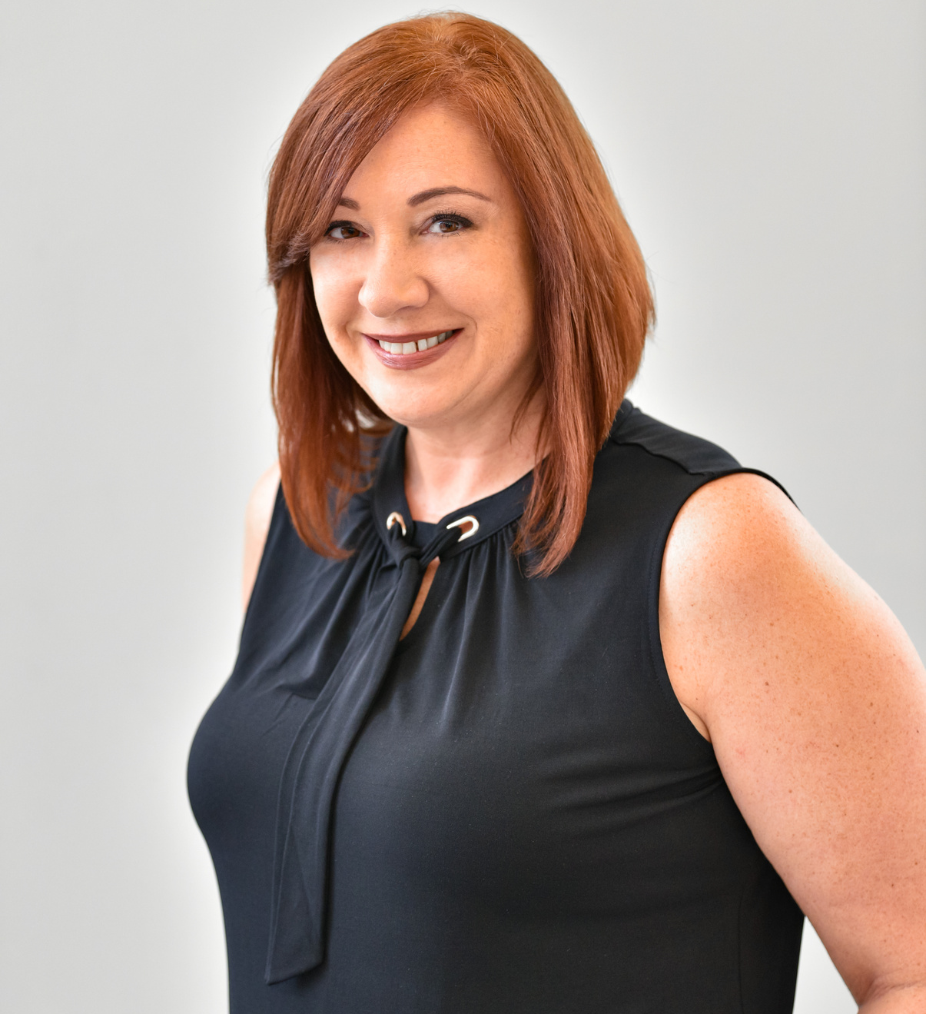
Ericka Lehman
Program Coordinator
SUNY Corning Community College
MY EXPERIENCE
Over 23 years of Marketing Experience;
Over 23 years of New Business & Networking experience;
Over 23 years of Advertising "sales" experience in Radio & Broadcast Television;
Currently Program Coordinator at SUNY Corning Community College;
Responsible for Non-Profit and Human Resources Sectors;
Help coordinate & plan the Marketing in our Workforce Department across our Social Media platforms and maintain our website.

Slide 3
WHAT IS MARKETING?
"THE ACTION OR BUSINESS OF PROMOTING AND SELLING PRODUCTS OR SERVICES, INCLUDING MARKET RESEARCH AND ADVERTISING."
DICTIONARY.COM DEFINITION
Marketing is the activity of getting people aware of and interested in a brand and its products, often by promoting its offerings so that customers perceive them as valuable or desirable.

Slide 4
ROLE OF A
OF MARKETER
THE ROLE OF A MARKETER IS TO INCREASE BRAND
AWARENESS AND LOYALTY.
TO ATTRACT NEW CUSTOMERS AND RETAIN EXISTING ONES.
ULTIMATELY CREATING MORE SALES REVENUE FOR THEIR COMPANY.

Slide 5
4 P'S OF
MARKETING
Product
Price
Place
Promotion

Slide 6
ADVERTISING
Only 1 Component of the Marketing Process
Spreads Top of the Mind Awareness
Includes placement of "ads" in
various mediums
Radio
Television (Broadcast or Cable)
Digital Media
Direct Mail
Billboards
Most expensive - $$$$
Part of bigger plan

Slide 7
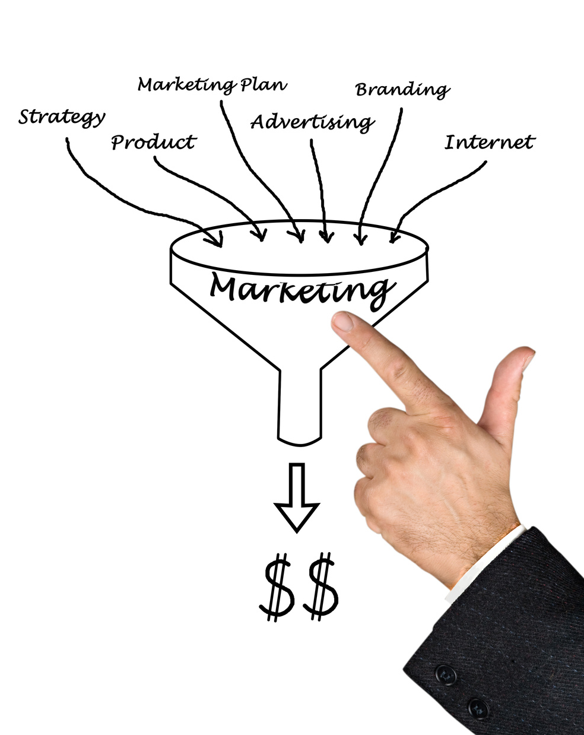
PLANNING
Establish Department Goals
(Weekly – Monthly – Quarterly –Yearly)
Meet with Marketing Director
Research – Strategize – Research
Create A Marketing Plan
Implement Plan
Monitor Advertising
Organize Results
Start All Over Again

Slide 8
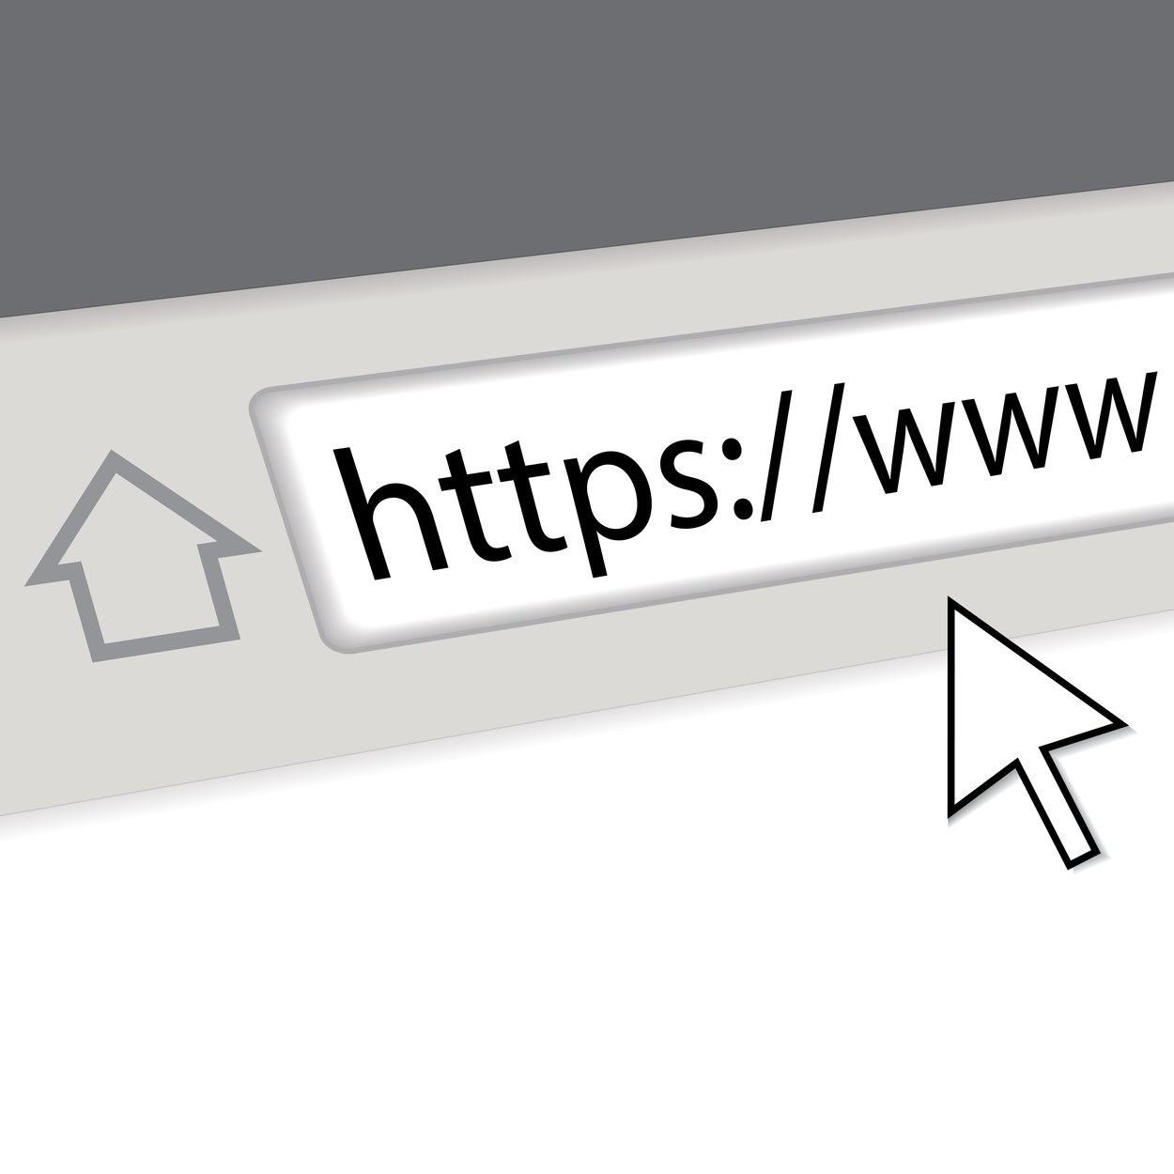
DO I NEED TO SPEND $$
NO!!!!! LITTLE TO NONE
WEBSITE
SOCIAL
MEDIA
EMAIL
IN-HOUSE
EVENTS
NETWORKING
REFERRALS

Slide 9
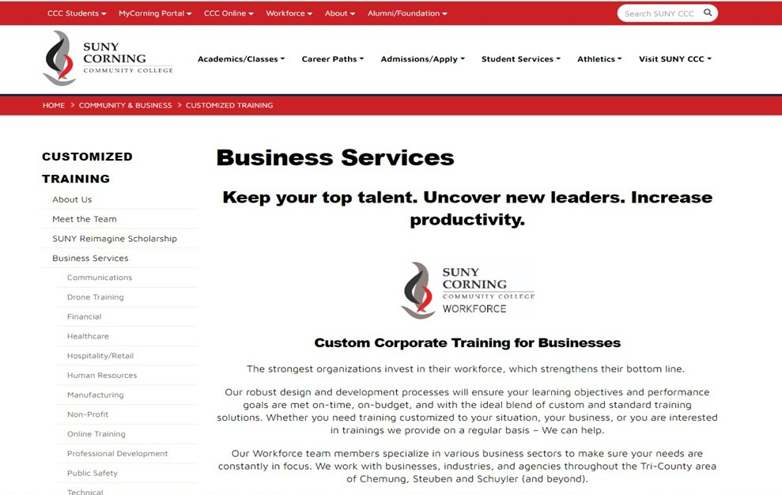
Website

Slide 10
Website Marketing
Website marketing is the process of promoting your website on the Internet.
It is one of the online marketing channels you can use as part of your overall digital marketing strategy.
The main goal of a website marketing is to get more visits to your website.
Website marketing strategy can help your business attract new customers and ultimately expand your business’s share of the market.

Slide 11
How to Promote Your Website
Search Engine Optimization (SEO)
Email Marketing
Email Signature
Social Media Marketing

Slide 14
Social Media Outlets

Slide 15
Yes?!
AWESOME!!!
NO?
WHY NOT?!!!!!
Benefits of Social Media
Grow Your Business
Drive Traffic to your Website
Customer & Audience Engagement
Direct Dialogue
Stay Top of Mind
Generates Leads
Promote Your Content
Possibility of Posts Going Viral
Learn More About Your Client/Customers
Keep an Eye on What other Colleges are doing Nationwide

Slide 16
FACEBOOK
DO'S
SOCIAL MEDIA
WEBSITE
EMAIL MARKETING
IN-HOUSE EVENTS
INFO WEBINARS
NO NEED TO SPEND MONEY
POST MINIMUM OF 2-3 TIMES PER DAY
DO NOT REPEAT POST MORE THAN 1 TIME PER WEEK
SCHEDULE YOUR POSTS
TRY TO ALWAYS USE A GRAPHIC IN POSTS - VISUALS
CALL TO ACTION IN POSTS
LINK WEBSITE IN POSTS
POSTS SHORT & SWEET
ALL PHOTOS & GRAPHICS SHOULD LOOK GREAT
DO FACEBOOK LIVE SESSIONS
ADD HIGHLIGHT EVENTS & MILESTONES
POST ON THE WEEKEND
RESPOND TO COMMENTS
THANK FOLLOWERS PERIODICALLY
USE FACEBOOK INSIGHTS TO ANALYZE PERFORMANCE

Slide 17
FACEBOOK DON’TS
Do Not Over Post
Do Not Go Hashtag Crazy
Do Not Use Bad Grammar
Do Not Post Low Quality Images
Do Not Share Anything Personal
Do Not Be Shy
Do Not Overshare
Do Not Talk Politics or Religion
Do Not Respond Hastily
Never Bad Mouth ANYONE!!!
Never Post Inappropriate Content!

Slide 18
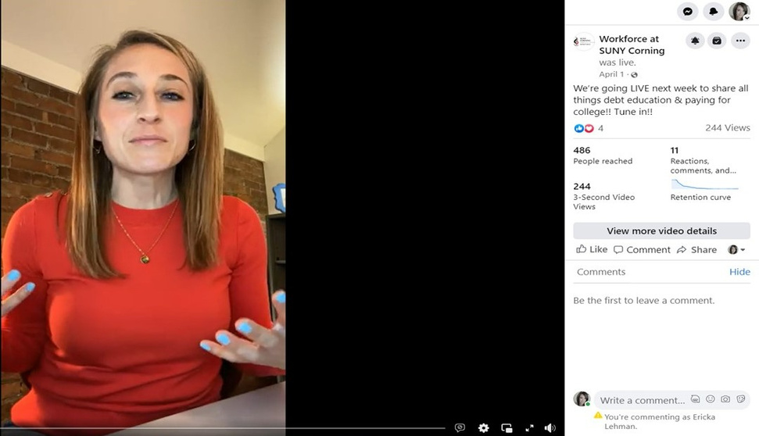
FACEBOOK POST SAMPLES

Slide 19
INSTAGRAM
DO'S
Design a Consistent Visual Look
Use Hashtags # Liberally (4-5 Max)
Work to Boost Engagement
Engage with Followers
Track & Measure Key Metrics

Slide 20
INSTAGRAM
DON’TS
Do Not Be A Robot
Do Not Create Content Just Because
Do Not Forget About Insta (IG) Stories
Do Not Be Generic About It

Slide 21
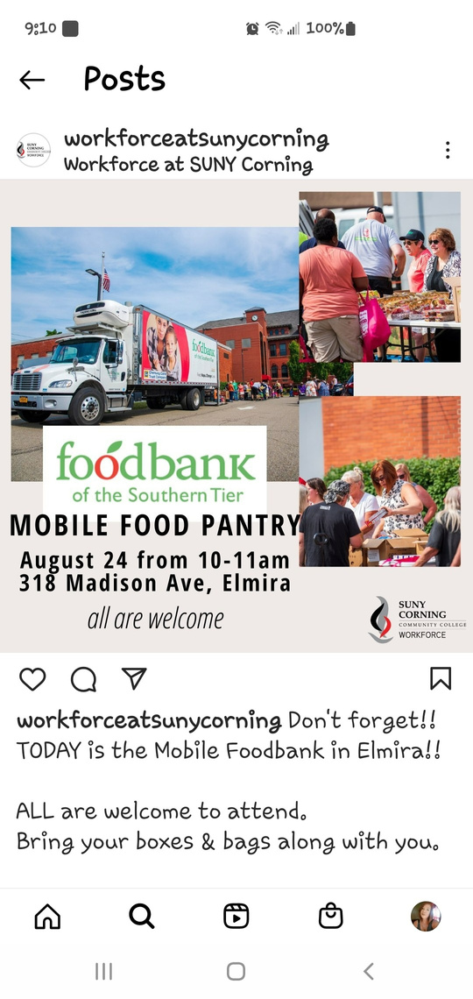
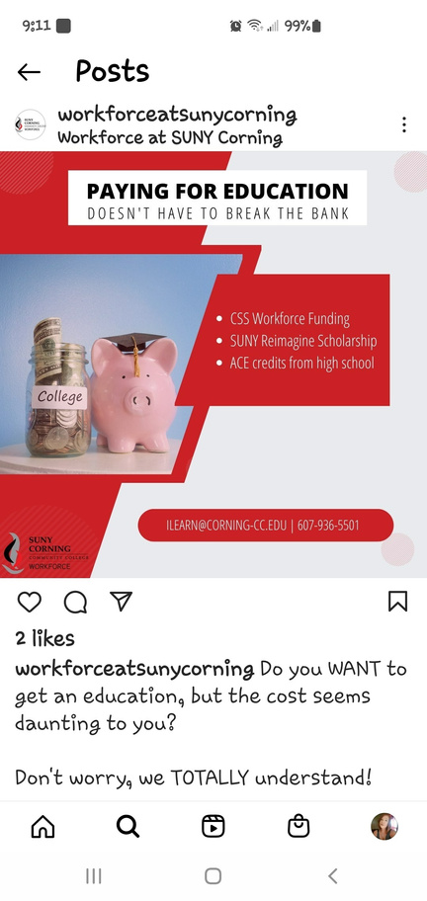
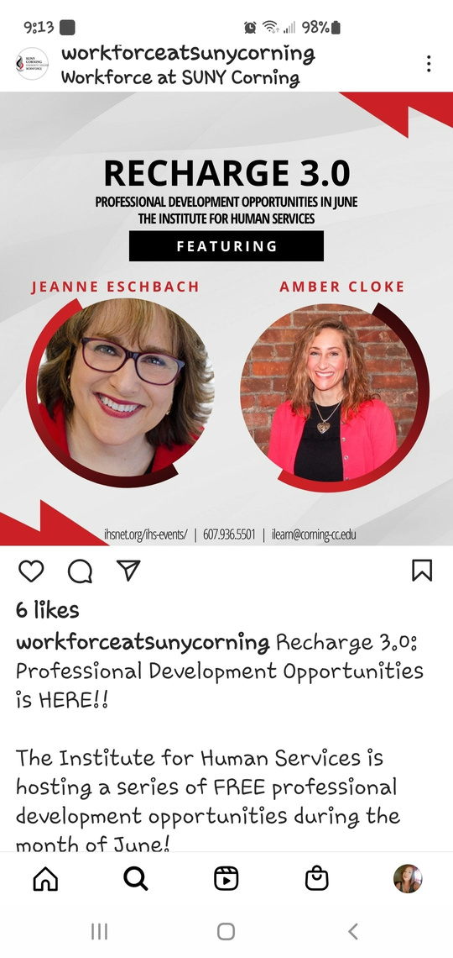
INSTAGRAM EXAMPLES

Slide 22
LINKEDIN
DO'S
Treat Your Page Like a Brochure
Be Consistent
Have a Call To Action
2-3 Posts per Day Max
Feature Your Team
Switch It Up - Curate Posts by Others
Use Hashtags
Be Professional
Message Only When Necessary

Slide 23
LINKEDIN DON’TS
Do Not Leave Your Banner Space Blank
Do Not Use Poor Grammar, Spelling or Punctuation Errors
Do Not Post Without A Plan
Do Not Focus on Generating Leads
Do Not Post & Ghost
Do Not Be Salesy
Do Not Post Text Updates Only - Have Fun!!
Do Not Forget Videos - Reels
Do Not Ignore the Analytics
Notes:
.

Slide 24
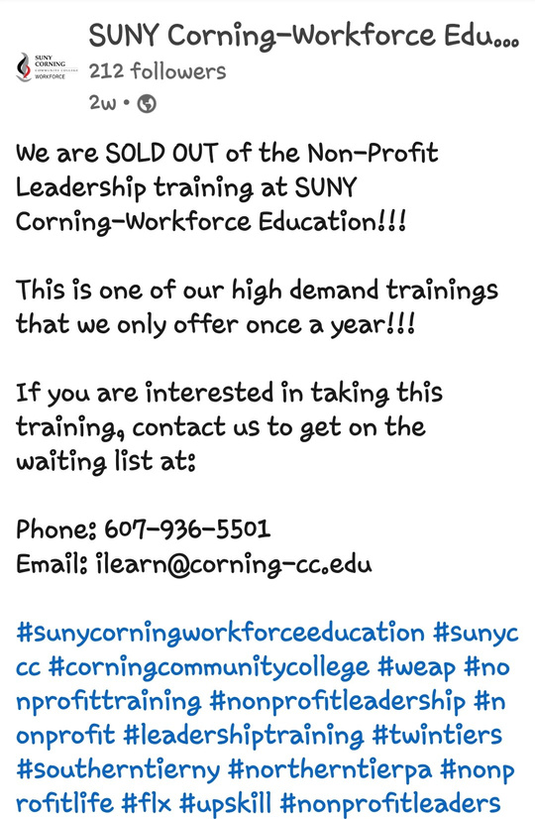
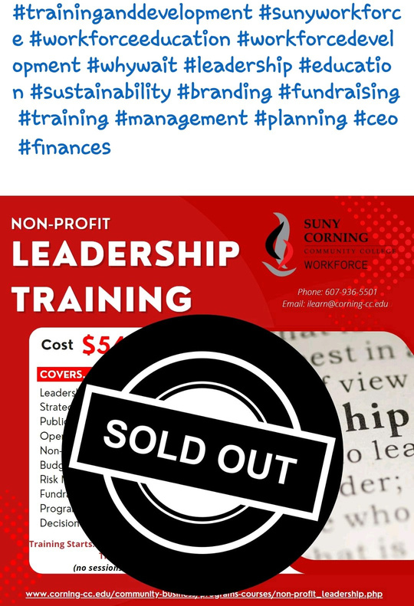
LinkedIn Sample Posts

Slide 25
TWITTER
DO'S
Include Images In Tweets
Fill Out Your Profile
Pin A Tweet
Retweet with Comments
Be Active
Vary Your Types of Posts
Use Hashtags # (4 Max)
Repost Your Posts
Link To Your Website

Slide 26
TWITTER
DON’TS
Do Not Use Poor Grammar
Do Not Be Shy
Do Not Go Crazy Using All
Capital Letters & Exclamation Points!!!
Do Not Use Long Links
Do Not Go Over 280 Characters
Do Not Send Out All of Your Tweets at Once

Slide 27
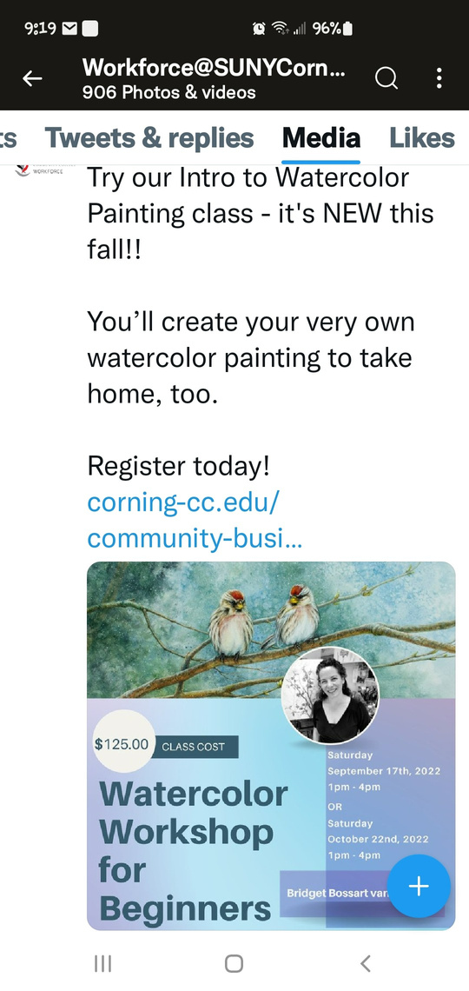
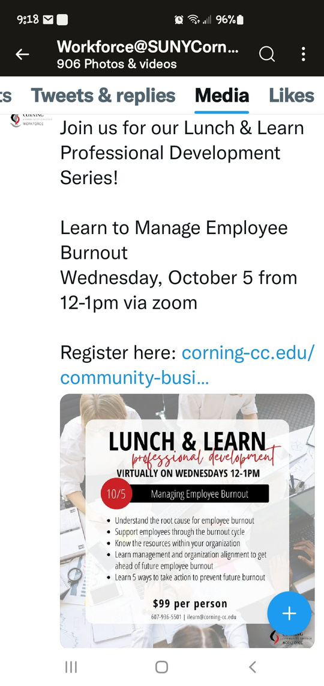
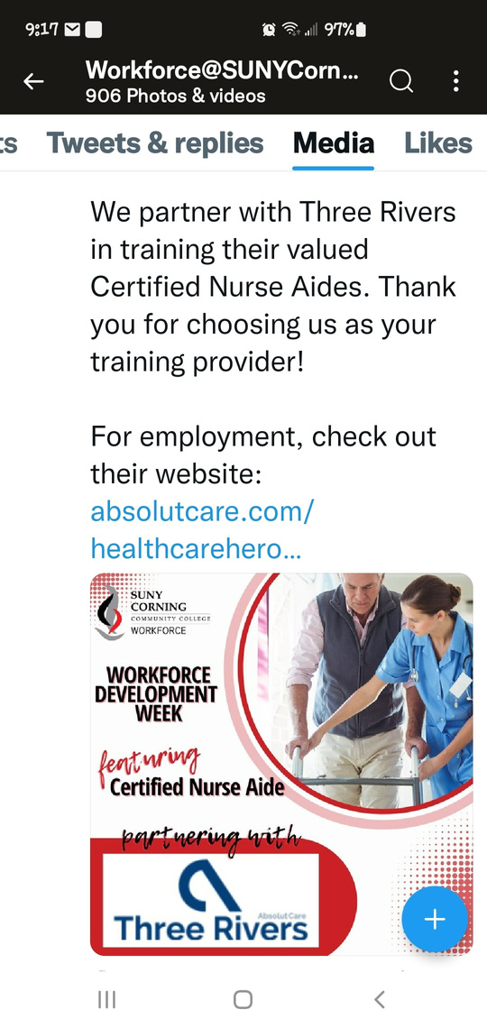
Twitter Sample Posts

Slide 28
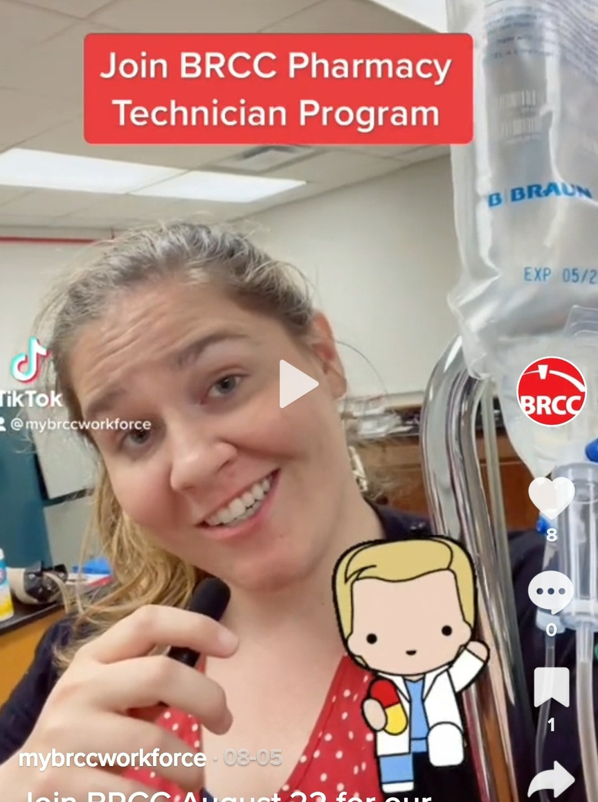
Baton Rouge
Community College
TIK TOK
BRCC Workforce Solutions
FALL
PHARMACY TECH
PROGRAM

Slide 29
TIK TOK DO'S
Be Authentic
Post Frequently
Switch It Up
Use Hashtags
Be Your Own Influencer on Campus!

Slide 30
TIK TOK DON'TS
Don't Sound Too Salesy
Don't Violate Any Rules
Don't Forget to Engage!
Don't Overuse Hashtags
Don't Get Overwhelmed!!

Slide 31
TIK TOK REELS
Share Them On:
Facebook
Instagram
SnapChat
LinkedIn

Slide 32
SNAPCHAT
BENEFITS
Drive Traffic to Website & Social Media Channels
Will Boost Engagement With Customers
Will Create Brand Awareness
Will Connect With a Broader Range of People
(Younger Demo)
Another Way to Interact with Your Content

Slide 33
Social Media Do's & Don'ts
DO: Complete and Update Your Social Media Pages & Profiles
DO: Separate Business and Personal
Do: Think Before You Share
DO: Prioritize Your Social Media Platforms
DO: Interact with Your Audience/Followers
DO: Post Regularly – Maximum 3x a Day
DO: Help More Than You Sell – Educate!
DO: Watch Your Grammar, Punctuation and Spelling
DO: Handle Criticism Gracefully
DO: Match Your Content To The Social Media Platform
DO: Be Visual
DO: Location Tag Other Businesses

Slide 34
Social Media Do's & Don'ts
Do Not: Be Needy
Do Not: Be a Spammer
Do Not: Complain
DO NOT: WRITE IN ALL CAPS
Do Not: #Abuse #Hashtags
Do Not: Share the Exact Same Message Again & Again
Do Not: Share Without Researching First
Do Not: Automate Without Thought
Do Not: Obsess about the Metrics and Numbers

Slide 35
SHOW OFF YOUR TEAM
LET EVERYONE GET TO KNOW WHO YOUR TEAM IS
USE YOUR WEBSITE
USE YOUR SOCIAL MEDIA PLATFORMS

Slide 36
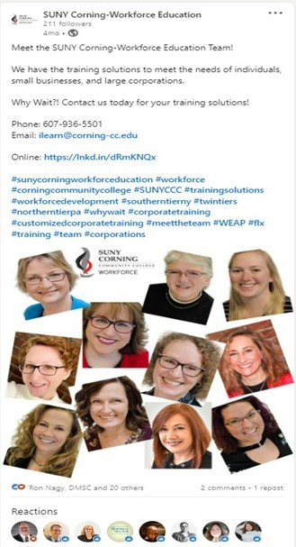
Show Off Your Team!

Slide 38
Email Marketing Campaign
Attention Grabbing Header/ Title
Call To Action
Easy to Read Content/Message
Correct Grammar ~ Punctuation or Style
Graphics Attached If Possible
THINK
REFINE
CREATE

Slide 39
TOOLS
MASS EMAILS/
MAIL MERGE
GRAPHIC CREATOR/DESIGN
SOCIAL MEDIA SCHEDULER
Constant Contact
Mail Meteor
GMASS
Mailchimp
SendInBlue
MailJet
Canva - Free
Adobe InDesign
Adobe PhotoShop
Adobe Express - Free
Vista Create - Free
Later
Social Pilot
HooteSuite
SocialBee
Sprout Social
FREE / LOW COST
FREE / LOW COST
COST VARIES

Slide 40
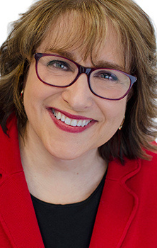
Networking
IT CAN LEAD TO NEW BUSINESS & REFERRALS
IT MAKES YOU A POTENTIAL RESOURCE
2
IT CAN LEAD TO NEW IDEAS & PERSPECTIVES
IT GIVES YOU ACCESS TO INDUSTRY INFLUENCERS
3
KEEPS YOU IN THE KNOW
NETWORK EVERYWHERE!!!!

Slide 41
Relationships!!!
Relationships!!!!
Relationships!!!!

Slide 42
Relationships
We Need Them!!!
Item 1
20%
People will not only buy trainings because they need them - they will buy them because they trust you because of your relationship that you have established with them!
Item 2
80%

Slide 43
CLIENT TESTIMONIALS
FROM SOCIAL MEDIA
ASK FOR THEM
"We are VERY proud of our partnership with both SUNY Corning and GST BOCES! Looking forward to continuing to build the next generation of manufacturers together!
Anyone interested in learning Machine Tool Trades? Hardinge will provide you with FREE training at GST BOCES."
Liz - Hardinge on LinkedIn
"Our Care Partner trainees really enjoyed their experience. They raved about the CCC Workforce CNA Instructors and felt they provided thorough and comprehensive training. They were well prepared and ready to join our healthcare team at the conclusion of the training program. The planning team was great to work with and was flexible to meet our needs."
Sally - Guthrie via email

Slide 44
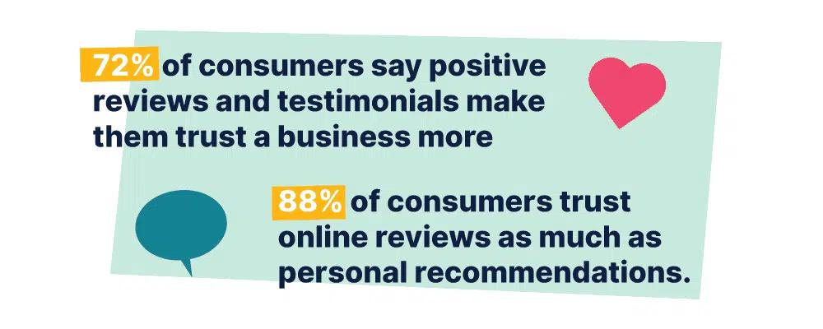
Builds Trust & Credibility
Provides Social Proof
Shows How a Client's Problem/Pain Points were Solved
Humanizes Your Brand/Service
Increases Conversions

Slide 45
IN- HOUSE EVENTS
ARE YOU HAVING AN IN-HOUSE EVENT AT LEAST ONCE A QUARTER OR TWICE A YEAR?
Target Audience (Depends on Showcase)
Snacks & Drinks (low cost $)
Depends on Audience
Chamber Business After Business
Short-Term Training & Funding Seminars
SUNY Corning Workforce Elmira Activate
Corporate Training Seminar
Targets just Businesses

Slide 46
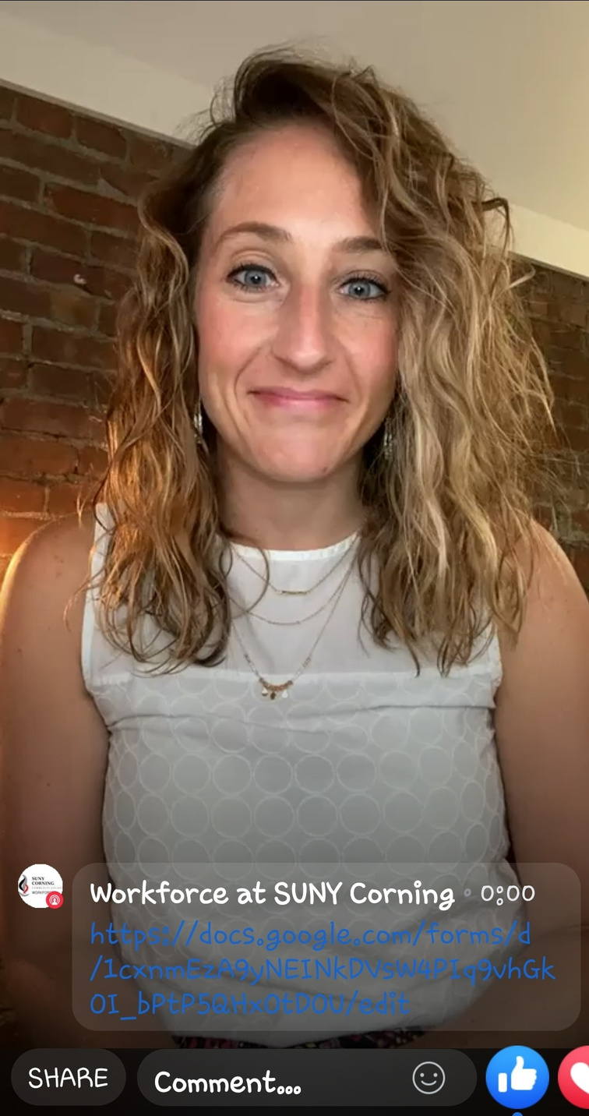
FaceBook Live
Mass Emails
Social Media
Postings
Morning Show News Interview

Slide 47
SMALL GROUP DISCUSSION
Groups of 2 or 3
Challenges & Success
In Marketing

Slide 50
Thank You

