Slide 1
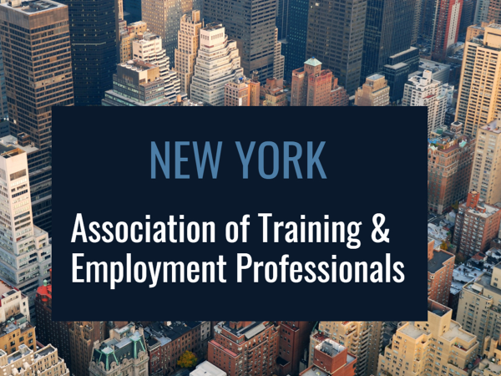
CEANY South Presentation
May 21, 2018

Slide 2
What we will discuss…
What is the current state of the labor market?
Who is working – who is entering the workforce?
What sectors are growing or need replacement workers?
Major trends to watch.
The impact of the “gig economy” and “millennials” on the labor market
How will the State and Federal policy influence where we spend our time and money?

Slide 3
The Future of Work is Changing
Including WHO is in the workforce
And, the jobs that are growing and in demand

Slide 4
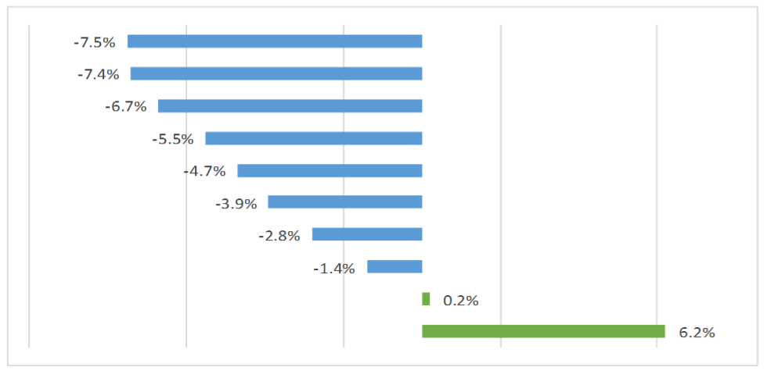
In most of the State we’re facing a labor shortage!
REGIONAL CHANGES IN THE LABOR FORCE, 2010—2015
Southern Tier
North Country
Mohawk Valley
Central New York
Western New York
Finger Lakes
Capital Region
Hudson Valley
Long Island
New York City

Slide 5
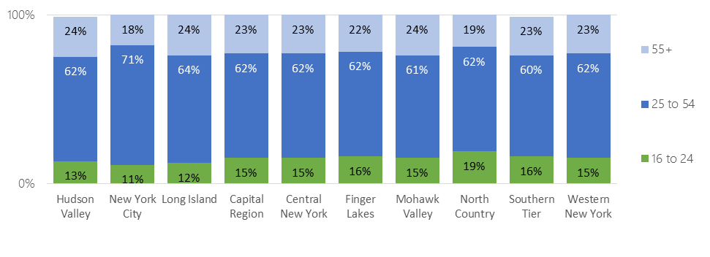
The workforce is aging Statewide…
REGIONAL LABOR FORCE PARTICIPATION BY AGE GROUP

Slide 6
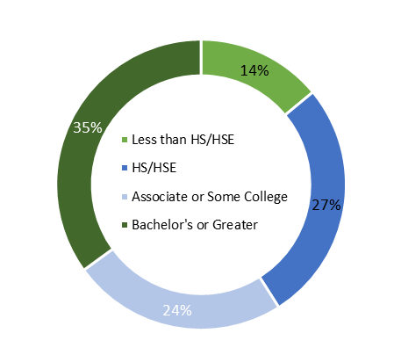
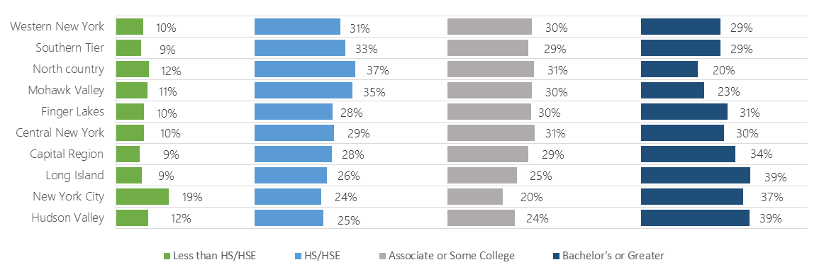
To close the skills gap we have work to do.
Statewide Educational Attainment
EDUCATIONAL ATTAINMENT BY REGION
Western New York
Southern Tier
North Country
Mohawk Valley
Finger Lakes
Central New York
Capital Region
Long Island
New York City
Hudson Valley

Slide 7
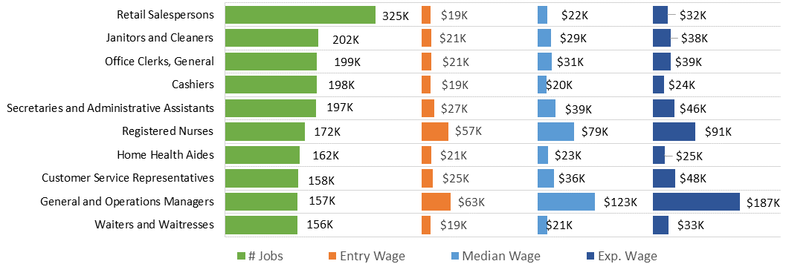
If we want to see the next generation economy…we need to attract higher skill jobs
10 LARGEST OCCUPATIONS STATEWIDE, 2016²⁷
Top 10 Occupation Expected to add the most jobs from 2014 to 2024

Slide 8
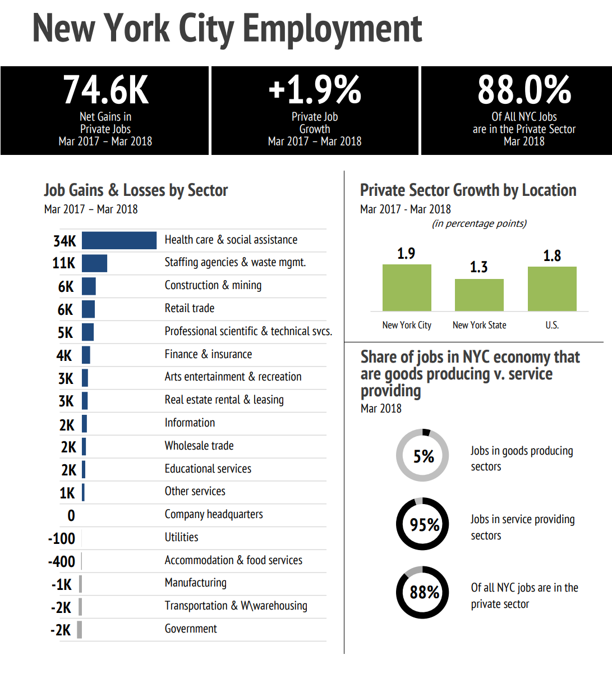
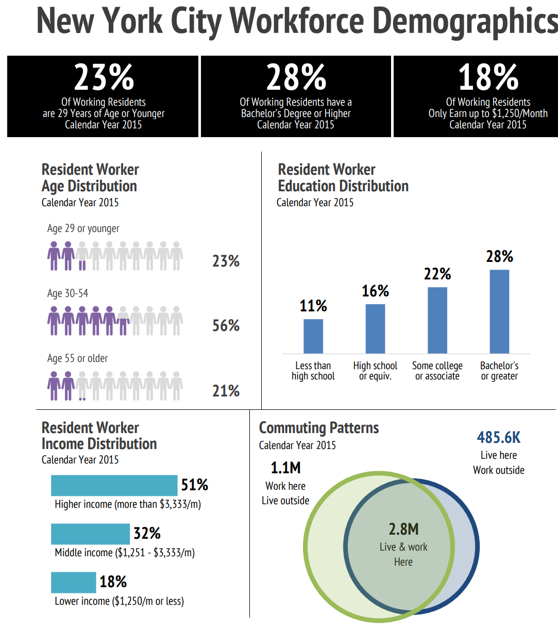
Notes:
Source: NYC Labor Market Information Service Borough Brief, 2018

Slide 9
Areas that are impacting the Future of work
Technology
Gig- and Contract-work
Millennials

Slide 10
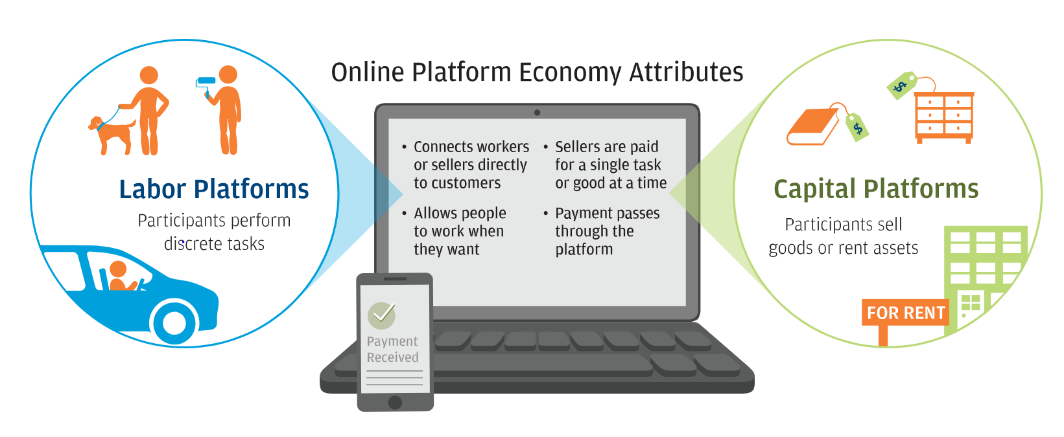
Notes:
https://www.jpmorganchase.com/corporate/institute/report-paychecks-paydays-and-the-online-platform-economy.htm

Slide 12
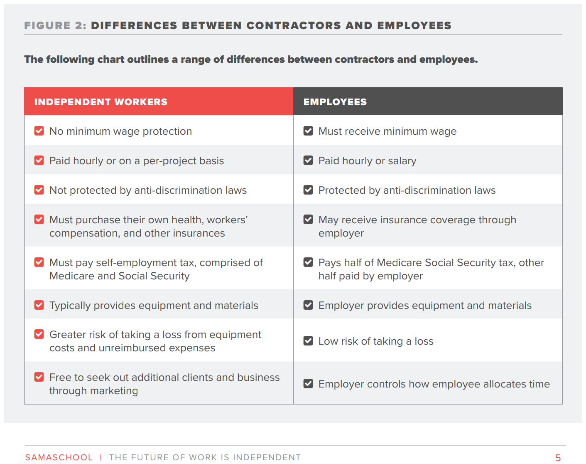
How do I know what a “gig” job is?
https://www.upwork.com/i/freelancer-categories/

Slide 13
What are gig jobs?
The Pew Research Center estimated 8% of Americans who earned money in the last year through online job platforms performed at least one of the following tasks:
Online tasks through digital job platforms
Ride-hailing services
Basic tasks, such as moving furniture or working as a parking lot attendant, providing personal services
Highly- specialized work, such as providing legal services, manuscript editing, or IT consulting

Slide 15
Some “gig work” is “offline”
House cleaning,
House painting,
Yard or landscaping work;
Babysitting and/or child care services; and
Personal services such as picking up dry cleaning, providing moving assistance, and dog walking; among other services.
This Photo by Unknown Author is licensed under CC BY-SA

Slide 16
The Best Paying “gig” jobs are in tech…
Artificial intelligence (AI)/Deep learning (Tensorflow, Python, R, Java, Matlab, Perl, and C++) $115.06/hour
Blockchain architecture (C++, Python, and Solidity) $87.05/hour
Robotics $77.46/hour (SolidWorks Professional, Photoview 360, Simplify 3D, and eDrawings)
Ethical hacking $66.33/hour
Cryptocurrency $65.37/hour
Amazon Web Services (Lambda coding) $51.00/hour
Virtual reality (3-D modeling) Average salary: $50.18/hour
ReactJS developers (JavaScript; HTML5; CSS) $40.75/hour
Apple Final Cut Pro editors $37.12/hour
Instagram marketing $31.23/hour
About ½ of the specialized independent workforce provides professional services; with 1/3 offering technical services
https://www.techrepublic.com/article/the-10-highest-paying-gig-economy-jobs-are-all-in-tech/

Slide 17
Potential changes underway…
What makes worker an employee?
The California Supreme Court used criteria called the “ABC test” in a ruling that drivers for delivery service Dynamex are employees. The test says a worker is an independent contractor only if all of these apply:
The company hiring the worker does not control or direct how the work is performed.
The worker does work that is outside the usual course of the hiring company’s business.
The worker runs an independent business doing the same kind of work performed for the hiring company.

Slide 18
How can we help those seeking “gig”work?
Skills Development Needed
Connections & Support
Soft Skills:
Customer service orientation;
Time management;
Self-motivation/self-direction; Professionalism;
Ability to communicate
Self-employment Skills:
Marketing
Financial Literacy including how to pay taxes, obtain benefits
Estimate costs and price services;
Understanding legal rights and obligations including how to write and read contracts.
Coaching and Interviewing for “Gig Jobs”
Gig Job Fairs/Recruitment Events
Resume Support
Gig’s as work experience/Internships
Career Pathways development
Notes:
Gig work can also help workers develop job-seeking skills, provide work experience, or fill in gaps in resumes,
difference between gig work for low-skilled workers and higherskilled workers. They said gig work is not as viable in the long run for workers who do not have the necessary technical skills.

Slide 19
The U.S. Gov’t Accountability Office (GAO) found that 40% of workers were under 34.
About 47% of millennials, compared to 36% of the total U.S. workforce, already engage in freelance work, and more than half of all U.S. workers are expected to freelance by 2027.”
Notes:
A recent study by Upwork, https://www.upwork.com/press/2017/10/17/freelancing-in-america-2017/

Slide 20
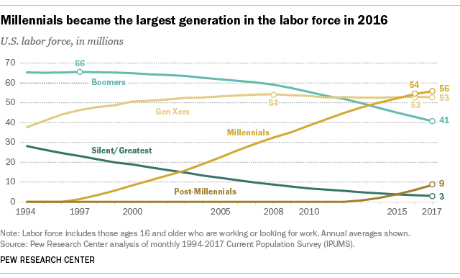

Slide 21
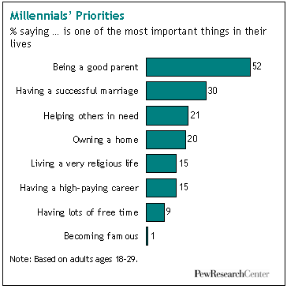
Engaging Millennials at Work
Want to connect to the “why”
They prefer a ‘flat’ work environment
Tech savvy
Task oriented NOT time oriented
Continuous learners
Want feedback (and recognition)
Want to enjoy what they do

Slide 22
Policy Issues to Watch

Slide 23
What happens in D.C. matters to New York…
$30 million increase in Adult and Youth Workforce Funding and $35 million increase for adult education
$145 million for Apprenticeship
$75 million increase in career and technical education state grants under the Carl Perkins Act
An increase in the maximum Pell Grant award, from the current $5,920 per year to $6,095 for the 2018-19 academic year.
Pay attention to the Higher Education Act, Perkins Reauthorization and Temporary Assistance for Needy Families

Slide 24
Executive Order on Work Requirements
The Executive Order directs the Secretaries of the Treasury, Agriculture, Commerce, Labor, Health and Human Services, Housing and Urban Development, Transportation, and Education to undertake a 90 day review process to:
Review all current regulations and guidance relating to waivers or exemptions to work requirements in programs under their jurisdiction
Review all public assistance programs that do not require work as a condition of eligibility, and determine whether a work requirement could be imposed
Review all public assistance programs that do require work as a condition of eligibility and determine whether enforcement of those requirements is consistent with a set of “economic mobility” principles set forth in the order.

Slide 25
NYS Investments in Economic Development
Regional Economic Development Councils: The Budget includes core capital and tax-credit funding that will be combined with a wide range of existing agency programs for an eighth round of REDC awards totaling $750 million.
Downtown Revitalization Initiative: The FY 2019 Budget provides $100 million for the Downtown Revitalization Program Round III.
Create Photonics Attraction Fund in Rochester: New York State will dedicate $30 million to a Photonics Attraction Fund, administered through the Finger Lakes Regional Economic Development Council, to attract integrated photonics companies to set up their manufacturing operations in the greater Rochester area.
Life Sciences: The Budget includes $600 million to support construction of a world-class, state-of-the-art life sciences public health laboratory in the Capital District that will promote collaborative public/private research and development partnerships.
Enhance North Country Lodging: The State will provide the North Country region with tools and resources to bolster tourism in the North Country and catalyze private investment in lodging. Empire State Development will commission a study to identify lodging development opportunities in the Adirondacks and Thousand Island regions, and provide $13 million in capital funding through the REDCs and Upstate Revitalization Initiative to spur development activity.

Slide 26
The State’s Strategy for Workforce
Establishes $175 Million Consolidated Funding Application for Workforce Investments in Emerging Fields through the REDCs
Creates Office of Workforce Development to Oversee State's Investments and Execution -- Headed by New Director of Workforce Development
Launches One-Stop Shop to Help Workers and Businesses Navigate Workforce Development Programs
Enforces Accountability Standards for Program Performance and Employs State-of-the-Art Data Analytics to Strategically Target Local Workforce Needs Across NY
#InvestInSkillsNY

Slide 27
What does this mean for workforce development?
Get ahead of the technology shifts
Advocate for what you do -- we shouldn’t be ‘best kept secrets’ – ESPECIALLY with State Investment. No Reinvent the Wheel!
DATA – DATA – DATA
Resistance to Change – be the field of ‘what if we’…
Partner for business development – Business NEED workers

Slide 28
What you can do right now!
Engage
Engage young adults early and often; work experience – lead with assets not deficits
Invest
Invest in incumbent worker training and those with high school diplomas or less - - especially as the technology changes the landscape of work
Recognize
Recognize the changing ‘requirements’ of the workforce – workers are not just there to create profit (and retaining workers adds to the bottom-line)
Integrate
Integrate the economic development and workforce development systems; Solve employer “pain points”

Slide 29
Be Part of the Movement!
Melinda Mack, Executive Director
www. nyatep.org mmack@nyatep.org
Save the Date:
2018 Fall Conference October 9-11
Syracuse, New York
www.investinskillsny.org

