Slide 1
Institutional Student Learning Outcomes
Deborah Moeckel, SUNY Assistant Provost
SCoA Drive-In Workshops
Fall 2016
deborah.moeckel@suny.edu

Slide 2
Definitions

Slide 3
Definitions
Institutional Student Learning Outcomes: Required of all students except those in certificate programs. May be the same as MSCHE gen ed, but may also include additional disciplines or competencies. (Sustainability is an example of this.)

Slide 4
Definitions
Institutional Goals: Strategic Goals for the institution. May or may not include student learning. Example: Review institutional policies, processes, and procedures to increase access to adult learners.

Slide 5
Definitions
MSCHE General Education: quantitative and scientific reasoning, oral and written communication, critical analysis and reasoning, technological competency, information literacy, global awareness and cultural sensitivity. Required of all students except those in certificate programs. Must be mapped and assessed. No credit requirement.

Slide 6
Definitions
SUNY General Education: 7/10 Categories, two competencies, and 30 credits in AA and AS degrees, and in baccalaureate degrees in the first two years of study.
Does not require scientific reasoning.
Does not require values, ethics, or diverse perspectives.
Does not require SUNY GER of all degree programs.

Slide 7
Definitions
Program Learning Outcomes: after completing the academic program, students should be able to demonstrate these outcomes and competencies.
Program Outcomes: Typically include completion data such as graduation rates and placement rates. The government includes such factors as loan default rates as well.

Slide 8
Definitions
Core Values
May reflect institutional goals which are not student learning goals, depending on institutional mission.
For example:
Sustainability as a core value may be reflected in the physical plant, via recycling, solar energy, etc. without necessarily being included as a learning outcome in all degree programs.

Slide 9
ISLOs: Sources in the standards

Slide 10
ISLOs are not new
Institutional Student Learning Outcomes (ISLOs) are not new requirements. These have been part of Standard 14 and are now part of the new Standard V.

Slide 11
Institutional Student Learning Outcomes
Standard 14:
“Clearly articulated statements of expected student learning outcomes … at all levels (institution, degree/program, course) …that are:
Appropriately integrated with one another, consonant with the institution’s mission; and consonant with the standards of higher education and of the relevant disciplines.”
Standard V:
“Clearly stated educational goals at the institution and degree/program levels which are interrelated with one another, with relevant educational experiences, and with the institution’s mission.”

Slide 12
Institutional Student Learning Outcomes
Standard I: Mission and Goals
1. clearly defined mission and goals that…
d. guide faculty, administration, staff, and governing structures in making decisions related to planning, resource allocation, program and curricular development, and the definition of institutional and educational outcomes;
3. goals that focus on student learning and related outcomes and on institutional improvement… and are consistent with institutional mission;

Slide 13
Standard V: Assessment
2. organized and systematic assessments, conducted by faculty and/or appropriate professionals, evaluating the extent of student achievement of institutional and degree/program goals. Institutions should:
a. define meaningful curricular goals with defensible standards for evaluating whether students are achieving those goals;

Slide 14
Challenges
Connecting the dots among all SLOs and Goals
Ensuring that assessment results for student learning are also used for planning and resource allocation at the institutional and unit levels.

Slide 15
Assessment of ISLOs and General Education

Slide 16
MSCHE General Education Expectations
Standard III:
at institutions that offer undergraduate education, a general education program, freestanding or integrated into academic disciplines that:
a. offers a sufficient scope to draw students into new areas of intellectual experience, expanding their global awareness and cultural sensitivity, and preparing them to make well-reasoned judgments outside as well as within their academic field;

Slide 17
MSCHE General Education cont’d
Standard III:
at institutions that offer undergraduate education, a general education program, freestanding or integrated into academic disciplines that:
b. offers a curriculum designed so that students acquire and demonstrate essential skills including at least oral and written communication, scientific and quantitative reasoning, critical analysis and reasoning, technological competency, and information literacy. Consistent with mission, the general education program also includes the study of values, ethics, and diverse perspectives.”
For graduate and professional education (new and current standards), “opportunities for the development of research, scholarship, and independent thinking…” are required.

Slide 18
The Expectations
15 credits of gen ed for associate degrees, 30 credits for baccalaureate degrees, or the equivalent. (New standards do not include credit amounts.)
It is not necessary for gen ed to be delivered within programs or courses; alternative methods of delivery are permissible.
You have to be able to demonstrate how all students are able to obtain instruction in these outcomes. You must also be able to assess them. Curriculum maps should demonstrate how all students access these and how they are assessed. This is about program design and not student choice.
Program learning outcomes are not the same as general education outcomes or ISLOs. They may be limited to programs only.
Certificate programs are not included in this expectation.

Slide 19
Assessment
Expectations are for a “mature” assessment
program
Curricular offerings must be assessed consistently regardless of level, location or modality.
General education and/or ISLOs must also be assessed, whether they are delivered within courses or in an extracurricular or co-curricular manner. In this case, mapping is especially important.
There must be evidence of results being used to improve teaching and learning (assessment spiral).

Slide 20
Practical Realities and Examples

Slide 21
The Catchphrases
How do you know?
and
How do you show?

Slide 22
Sample Draft ISLOs

Slide 23
Questions
Must a student meet all of the objectives to have met the outcome?
How will this be tracked if the objectives cannot all be addressed in the same course?
How will this affect transfer students?

Slide 24
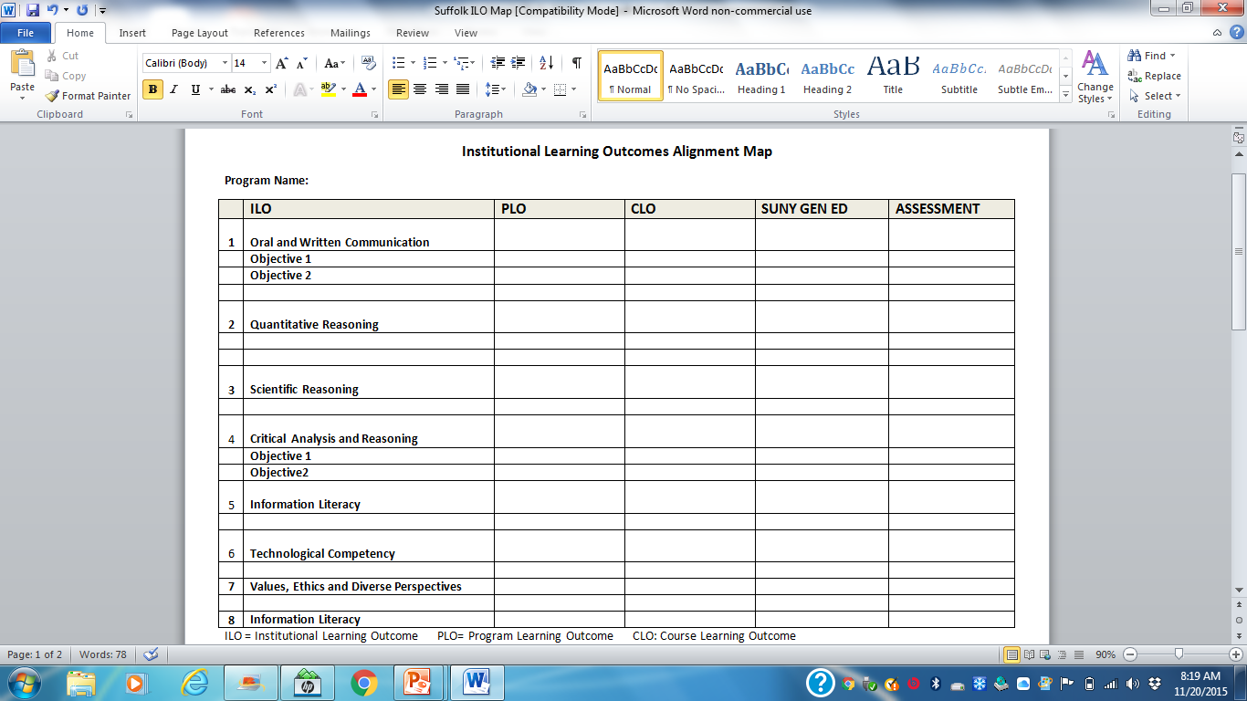

Slide 25
Course | ISLO | SUNY GER | MSCHE GER
ACC 101 Financial Accounting I
ACC 102 Financial Accounting II
ACC 116 Practical Accounting
ACC 137 Computer Accounting Principles | 12
ACC 212 Electronic Spreadsheet Applications OR
ACC 214 Corporate Finance
Accounting Eleective
BUS 101 Introduction to Business | 4 | SS
BUS 112 Computing for Business OR | 12 |  | TC
CST 101 Introduction to Computing | 12 |  | TC
BUS 115 College/Workplace seminar | 2
BUS 117 Business Communications | 13 | BC
ECO 111 Macroeconomics OR |  | SS
ECO 112 Microeconomics |  | SS
ENG 101 Standard Freshman Comp | 8,13 | BC (W) | WOC, IL
English Elective | 1,3,5 | H | CT, WOC,
Humanities Elective | 1,3,5 | H | VED?
LAW 111 Business Law I
LAW 112 Business Law II
Mathematics Elective | 10 | M | QR
Mathematics or Science Elective (Must specify science to meet ISLO) | 4,11 | NS | SR
Physical Education | 6
Social Science Elective | 7,9 | SS, AH, WC, OWC | IGK?
Must include outcomes from nonduplicated ISLO categories
Must include outcomes from all ISLO categories listed
Choices need clarification for ISLOs
ISLOs | Accounting Program Outcomes
1. Aesthetic Literacy
2. Collaboration and Problem Solving
3. Critical* and Creative Thinking
4. Environmental Awareness
5. Ethical Reasoning**
6. Health Awareness
7. Historical Awareness
8. Information Literacy*
9. Intercultural and Global Knowledge*
10. Quantitative Reasoning* | 2,3
11. Scientific Reasoning*
12. Technological Competency*
13. Written and Oral Communication* | 5
*Required by Middle States
**Middle States Optional

Slide 26
Observations
Some programs may require re-designation or restriction of electives to specify particular courses which meet the needed outcomes.
Many courses may meet only one of the objectives under a particular ISLO. This would need to be specified so that the full range of objectives under an ISLO may be addressed and assessed.
Some courses may need to add specific SLOs in order to demonstrate that the courses do address the topic in question. You can’t just assume.
In some cases where a choice of courses is indicated, you should check to ensure that any ISLO met by one course is met by the other(s) as well if this is the only place that the ISLO is addressed in the program.
Some indication in the map should be made to determine in which courses or in which alternative manner the ISLOs will be assessed.

Slide 27
Other Issues/Questions
Q: Is it OK just to use categories instead of actual outcomes? It seems like it would be easier.
A: No. Categories are not student learning outcomes. You won’t have valid assessment results.
Q: Don’t service areas need learning outcomes now? Wouldn’t this help with co-curricular ISLO assessment?
A: Some service areas such as those directly dealing with students such as advising, academic support, student development generally, student government, are being held accountable for student learning outcomes. In these cases, determining how all students access these outcomes is the issue. You may not want these to be the only way in which students access specific outcomes.

Slide 28
Is it worth the effort?
It’s a lot of work:
The processes are complex and labor intensive.
The more complicated and extensive the list of ISLOs, the more challenging the mapping process will be.
It’s likely that turf issues will arise.
On the other hand:
The institution may get clarity on value added.
Gaps will emerge which are important to address.
The discussions are valuable for clarifying institutional mission.
The connections to resource allocation may yield needed funding.
You can assess the assessment and make changes if the process is too labor intensive.
You probably get to remain accredited.

Slide 29
Discussion

