Slide 1
Professional Development Program
Rockefeller College University at Albany
Traveling the Evaluation Highway:
Using Data to Map the Way
November 11, 2016

Slide 2
Traveling the Evaluation Highway:
Using Data to Map the Way
2016 CEANY Conference
Susan Gieryic, Fazana Saleem-Ismail
and Arinka Abad

Slide 3
Session Agenda
Background on PDP
Overview of Early Childhood Education and Training Program (ECETP)
Overview of Videoconference (VC) training at PDP
Evaluation of VC training
Overview
Survey instruments used for VCs
Use of VC evaluation results
Video-on-Demand (VOD)
Overview
Pilot study of child day care centers as host sites
Evaluation results
Future plans

Slide 4
Session Objectives
By attending this session, you will learn:
How to measure different aspects of training
Types of survey instruments used to collect evaluation data
How to use evaluation data to inform future programming
How to conduct a pilot study of a new program under consideration
How to use evaluation data from a pilot study to make decisions regarding wider implementation

Slide 5
Background on PDP

Slide 6
PDP’s Strength
Transforming policy into practice:
Ability to bridge between policy and practice.
Ability to rapidly respond to emerging needs.
Ability to adjust to changing conditions.

Slide 7
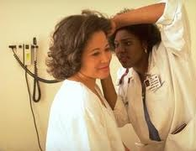
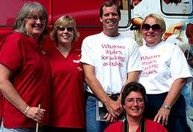
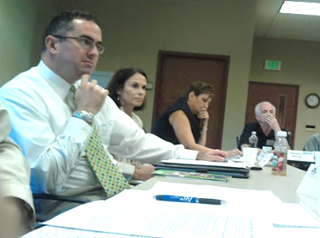
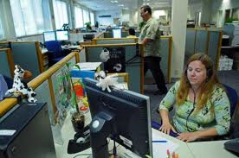
Mission
To provide education, training, research and evaluation in support of the public workforce, government agencies, not-for profits, and affiliated organizations.
Vision
Helping government
become more efficient.

Slide 8
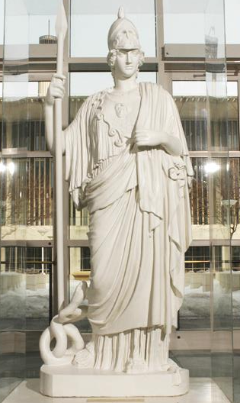
Value
Furthering the university’s public and community service mission (community engagement).
Respond to emerging workforce development needs.
Provide Continuing Professional Education (CPE) for the public workforce (training & technical assistance).
Creating opportunities for faculty and students.
Bridging policy and practice.

Slide 9
PDP’s Historical Trademark
Ability to:
work with diverse groups
cut through bureaucracy
be resourceful and creative
be results oriented
deliver “just-in-time” training.

Slide 10
PDP Five-Year Enrollment Data (2011 - 2016)

Slide 11
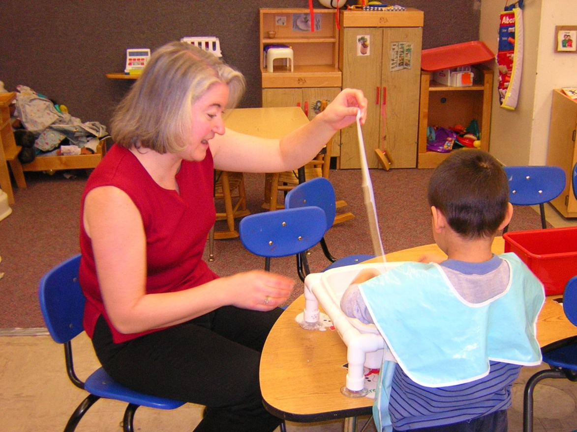
Early Childhood Education and Training Program (ECETP)

Slide 12
Early Childhood Education and Training Program (ECETP)
Offers training and educational activities that support the development of knowledge and skills needed by child care providers and regulators
Supports child care providers in their efforts to provide quality care
Programs include:
Educational Incentive Program (EIP)
Videoconference training (VC)
e-Learning/Distance Learning (DL)
Medication Administration Training
Health and Safety Training

Slide 13
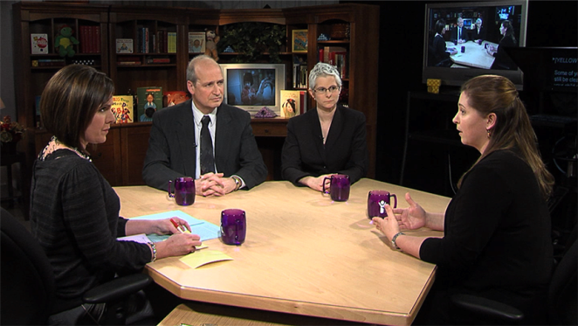
ECETP Videoconference Training

Slide 14
Videoconference training (VC) as part of ECETP
Offered at PDP since 2008
Are free and cover cutting-edge topics
Broadcast live to multiple training sites in NYS
Feature discussions with national and state experts
Facilitated by co-trainer(s) at each site
Held on pre-determined dates (usually in the evening)
Give participants 2.5 hours of training and .25 CEUs

Slide 15
VC Registration
Brochures sent out beginning of year to child day care providers on ECETP’s mailing list
Emails sent to day care providers on ECETP’s email list one month prior to each videoconference
Registration materials sent in via mail or fax or completed on-line
Most sign up at the beginning of
the year for all VCs
Some are signed up by supervisors

Slide 16
Number of Trainees Who Participated in VCs, 2011 - 2015

Slide 17
Evaluation of Videoconferences

Slide 18
Importance of Evaluation
Helps substantiate the positive influence of training programs and learning activities
Provides meaningful information from trainees
Helps determine if training/learning objectives have been achieved
Helps to identify gaps or areas that may require revision for future trainings/learning activities
Helps to justify budget costs for needed training/learning activities

Slide 19
Ongoing Training and Evaluation Cycle
On-going program evaluation is central for assessing project effectiveness and making informed decisions whether you are creating new or modifying existing training.
Training
and
Evaluation
Cycle
(1)
Deliver training
(2)
Evaluate/analyze results
(3)
Recommend changes if needed
(4)
Modify training based on new knowledge

Slide 20
Kirkpatrick Evaluation Model
Level | Learning Effect
Level 1 – Reaction | Were the trainees satisfied with training?
Level 2 – Learning | What learning knowledge took place?
Level 3 – Behavior | Was learning from the training transferred to the job?
Level 4 – Results | Did the training have the desired impact on the organization?
Kirkpatrick, D.L., Kirkpatrick, J.D. Implementing the Four Levels – A Practical Guide for Effective Evaluation of Training Programs (2007)

Slide 21
Participant Reaction Questionnaire (PRQ)
Please describe the course.
Please describe how you will apply what you have learned during this course.
What other topics would you like to see offered?

Slide 22
Aggregate PRQ Means of VC Trainings, 2014-2016

Slide 23
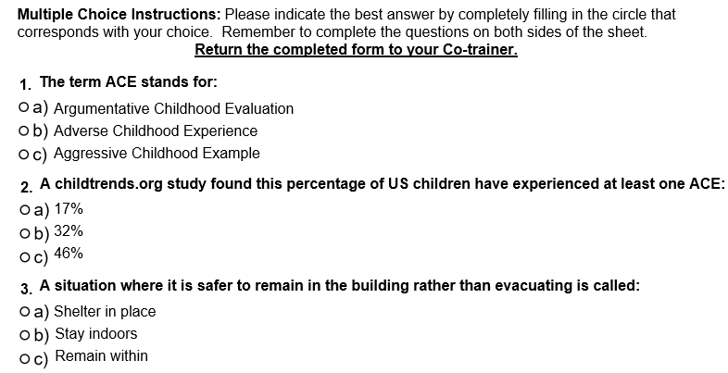
Example of a VC Post-test

Slide 24
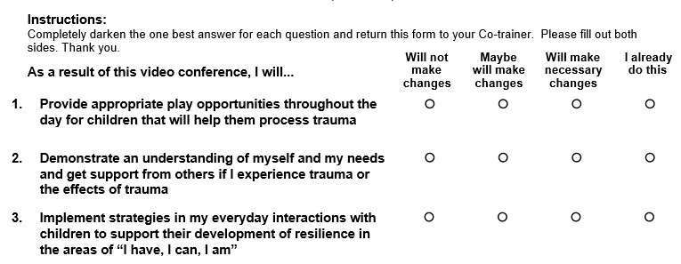
Example of VC “I will” statements

Slide 25
VC Participant Comments on Open-ended Questions
“Why aren't these very informative videoconferences available for training--as far as watching them again like the ones shown on the web?... I will be hiring staff during the summer and this would be a terrific training to give new staff. ”
“It was long but informative.”
“[It] was very informative and interesting and important but long after a full day’s work.”
“Very good conference; wish more staff attended it, especially new staff”

Slide 26
Comment by VC Participant
“It would be great if I could watch these videoconferences at my day care center. I do not have a car and have to take two buses to get to the VC site and get home after the event.
It would be convenient and ideal for me to attend the VC at my center.
I think more staff would attend if the videoconference was held at our day care center.”

Slide 27
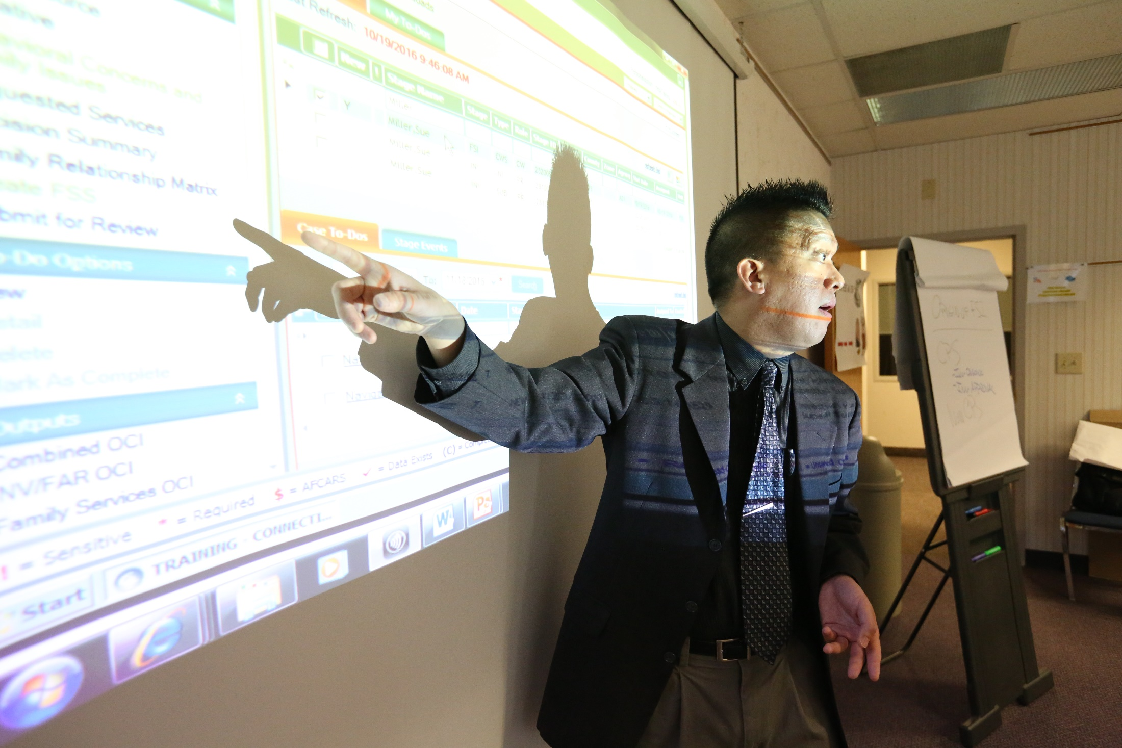
Video-on-Demand

Slide 28
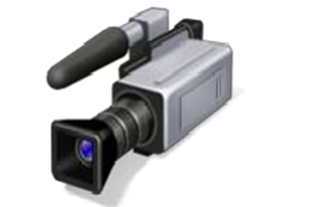
Video-on-Demand (VOD)
PDP plans to use VOD as an avenue to provide child day care providers with PDP’s well-received quality videoconferences.
VOD is defined as technology that supplies video content to users upon request and can be viewed when they choose to, rather than having to watch for a specific broadcast time, via television, personal computers or smart phones (Casey, 2015).

Slide 29
VOD in Television Field
“On-demand isn’t always the shiniest new technology. But we are seeing tremendous growth,” said Matthew Strauss, who oversees digital strategy for Comcast, the nation’s largest cable company.
Reference: Viewers Start to Embrace Television on Demand By Brian Stelter and Amy Chozickmay 20, 2013
http://www.nytimes.com/2013/05/21/business/media/video-on-demand-viewing-is-gaining-popularity.html

Slide 30
Literature Review on VOD
Advantages of VOD
Provides an interactive inter-media experience
Appeal to tech-savvy trainees
Accommodates a wide range of content
Is a learning model that could be monitored effectively
Can be self-directed and self-paced (asynchronous) or trainer-led on a specific schedule (synchronous)
Is more easily accessible than traditional VCs

Slide 31
Literature Review on VOD
Disadvantages of VOD
Can be difficult for some learners who are not tech-savvy
Is not as focused on individual learner’s needs for engagement and performance outcomes
Can overwhelm learners with lengthy sessions

Slide 32
Pilot Study of Child Day Care Centers as VC Host Sites
Purpose
In September 2013, a sample of child day care centers (N=3) were chosen to host VCs for their staff for remainder of year
Three VCs were available for viewing by sites
Evaluation design:
Level 1 PRQ surveys and Level 2 Post-tests for participants
Semi-structured telephone interviews with each participating director in 2014

Slide 33
Pilot Study of Child Day Care Centers as VC Host Sites
Survey Interview Questions for Directors
Could you share your experience of being a host videoconference site?
Did you face any challenges conducting the videoconferences?
Do you perceive any benefits from hosting the videoconference at your own center?
Has any of your staff attended ECETP videoconferences at other sites in the past? If yes, how do you think this experience compare to having it at your own site?
Do you have any suggestions/best practices to improve the host site project?
Would you suggest this model to other child day care directors?

Slide 34
Pilot Study of Child Day Care Centers as VC Host Sites
Evaluation Results
Participants at child day care host sites had very positive ratings on the Level 1 PRQ survey and high Level 2 post-test scores.
Participant evaluation results from host sites were comparable to the those of providers who took the same training, during the same time period, at traditional videoconference sites.

Slide 35
Pilot Study of Child Day Care Centers as VC Host Sites
Evaluation Results
Major themes of content analysis
Directors overwhelmingly liked being host sites
Preferred hosting the VCs at their centers
Benefit - more comfortable setting

Slide 36
Pilot Study of Child Day Care Centers as VC Host Sites
Evaluation Results
Major themes of content analysis
More time for questions and discussion
Attendance was very good at all the centers; in some cases, mandatory
Directors felt very prepared to co-train the VC

Slide 37
Pilot Study of Child Day Care Centers as VC Host Sites
Evaluation Results
The directors shared examples of staff applying the VC information to their classrooms:
One center went back to “Family-Style Eating” based on information provided in the Focus on Obesity Prevention VC.
One teacher adapted information from the Focus on Bullying VC to address a bullying issue in her pre-school class.
Several teachers checked and updated their classroom safety lists based on the information shared in the Focus on Child Day Care Regulations VC.

Slide 38
Pilot Study of Child Day Care Centers as VC Host Sites
Evaluation Results
Major themes of content analysis
No major technical problems or challenges
Enthusiastic desire to host in the future
Day care centers greatly benefitted from hosting VC

Slide 39
Current Status of PDP VOD for Child Day Care Providers
Since 2014, PDP has been working on providing VOD.
Website being developed for providers to access VOD.
Centers will need to met criteria to be eligible for using VOD.
Three VC topics will be accessible once VOD is a PDP training option:
Child Abuse and Maltreatment with a Focus on Understanding Brain Injury and Prevention
Continuity of Care
Family and Community Relationships with a Focus on Bullying during the School-Age Years

Slide 40
Evaluation Plans for Future VOD Option
The Level 1 PRQ and Post-test currently used at traditional sites will also be utilized to evaluate the VODs.
A potential study may be conducted to examine the effectiveness of the VOD approach.
The study could include a series of regional focus groups with both directors and staff who use, once available, the VODs at their center.
On-line Level 3 follow-up surveys could be sent to participants to assess if knowledge is being applied.

Slide 41
Summary
The pilot study of day care centers hosting the VCs provided valuable information that indicated this was both a positive and effective approach for providers to access VC training.
The evaluation results helped to fuel efforts to develop the VOD initiative.

Slide 42
QUESTIONS?

Slide 43
Contact Information
Susan Gieryic
sgieryic@albany.edu
Fazana Saleem-Ismail
fsaleem-ismail@albany.edu
Arinka Abad
aabad@Albany.edu

